Slide 1
Notes:
This slide will be used as an introduction slide for Stephen
As a system, we have a good system; process and system from PLCs to buses
However, as you will see in a few, we were beginning to flatline; that should scare us, right, and what we had was a culture of compliance, students were largely compliant, teachers were largely, compliant...we were the victims of a system born out of...compliance.
The superintendent embarked on a quest to hear from all the stakeholders and in this video, you will hear some of our student voices and our reaction
Use the video as a hook

Slide 2
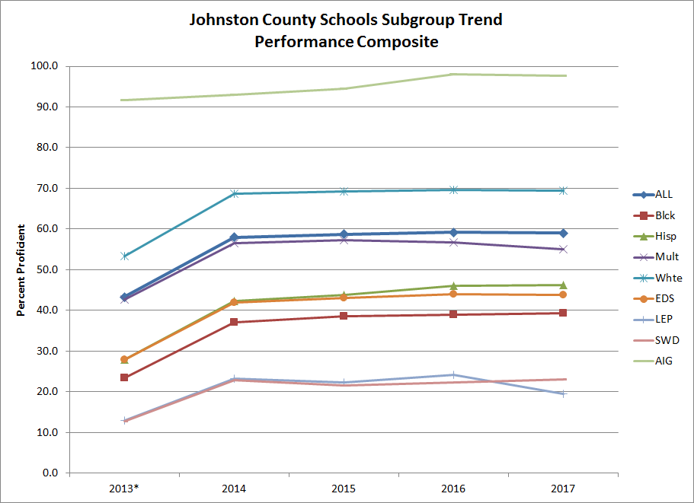
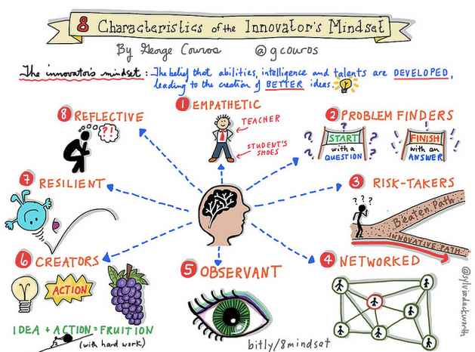
Moving from Summative to Formative...
Achievement
Significance
Notes:
Garland – reflection on the rationale for the focus of student-centered instruction to JoCo 2020
Kitchen table cabinet conversations
Population changes
Parent input
The need for change
For the past several years, we have seen a plateau in our proficiency data. Though the results themselves are not our why, we had to consider the data plateau alongside the famous 8 characteristics of an innovator’s mindset and ask ourselves what is more important, achievement or significance?

Slide 3
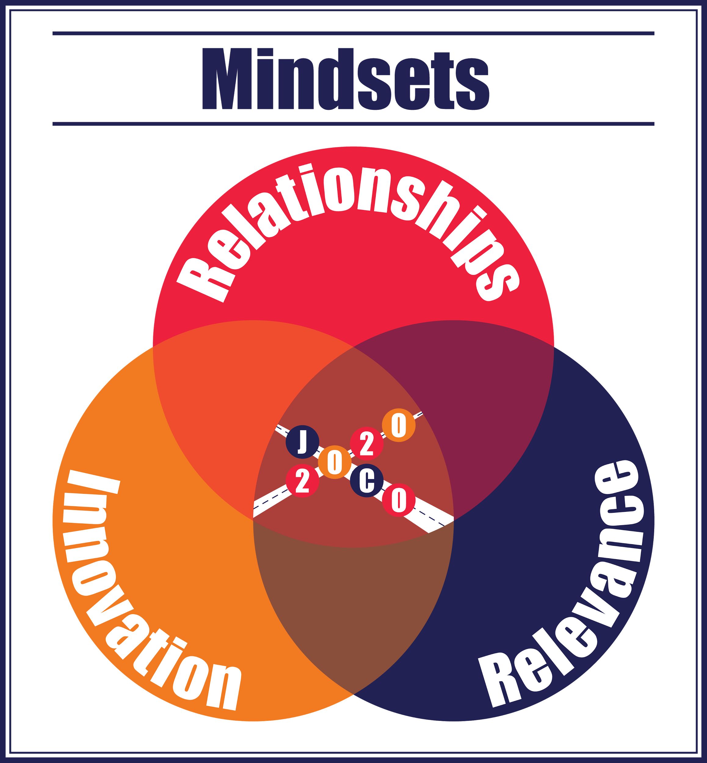
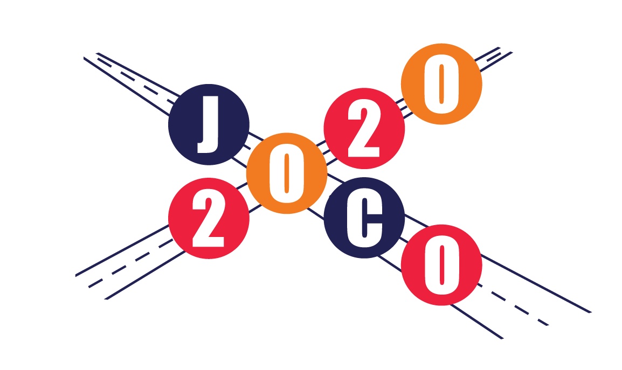
What is
JoCo 2020?
Notes:
stephen
Why Student-Centered Learning
Compliant students will often learn, but not being engaged, are not exactly enthusiastic. We wanted students excited to come to school and study: that led us to a laser focus on relatioships and voice and choice which led us to personalized learning which led us to JoCo 2020, a 3 year plan that leads to -the crossroads of Relationships, Innovation, Relevance

Slide 4
Notes:
We recently revisited our Vision, Mission, and Values and revised them so that they actually align with our JoCo 2020 Instructional Vision. As you see, the tenets of our vision are founded on relationships, relevance, and innovation.
Brandon will do vision and mission
SB will do values

Slide 5
Student Centered Instruction:
A collaborative partnership between teachers and students to foster student ownership of learning and demonstrating mastery of curriculum standards based on student interests and needs. (walkthrough tool)
Personalized Learning:
Personalized learning is the outcome of student centered instruction that embraces choice in how students learn and demonstrate mastery of standards based on their interests.
Notes:
Brandon – how did Johnston County define student-centered instruction and personalized learning?
Journey with principals (flipped meetings) (Baker come in with grade alike) power of discussion and exploration
Walkthrough tool to discover engagement
PBL
TLC/
Movement of standards based grading- cbl
Innovation Academy

Slide 6
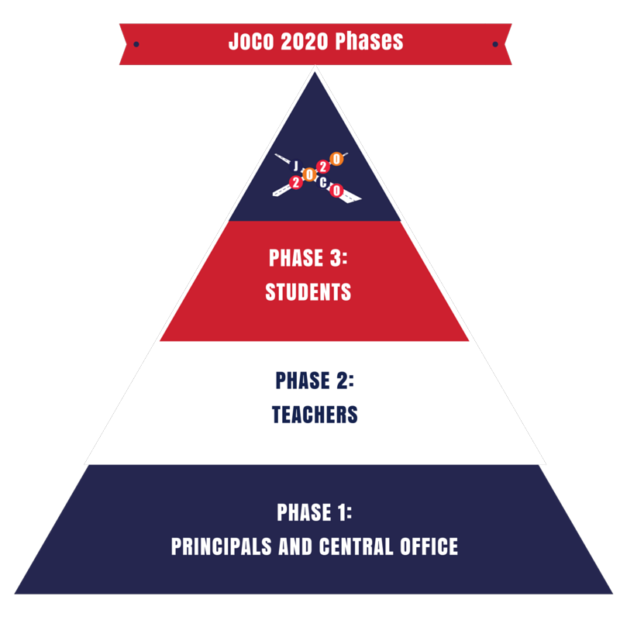
Notes:
How:
Brandon – How did you segment out the work? What were the big items you tackled first?
Phase 1 (walkthrough tool)
District messaging
Phase 2 (stephen)
Principals and School Improvement Teams have reworked school improvement plans to focus on Wildly Important Goals based on the work in Phase I
District realignment (Reset)
TLCs in every school
Opening of Innovation Academy
1st early release day
Aligned district wide PD
Comfortable with being uncomfortable
Starting with the why
1st early release day

