Slide 1
Every Student Succeeds Act
Update
Lou Fabrizio, Ph.D.
Federal Policy Director
Office of the State Superintendent
NC Department of Public Instruction
Central Carolina RESA
C&I Council Meeting
October 24, 2017

Slide 2
Agenda
State Plan – See http://www.ncpublicschools.org/succeeds/
Timeline (Plan submitted September 18, 2017, 120 days for USED approval – Peer Review Process)
Theory of Action
Accountability Model
Two Waivers will be Requested (seventh grade math exclusion and Targeted Support & Improvement (TSI)
Long-term Goals (10 years)
Schools Identified for Comprehensive Support & Improvement (CSI) & TSI

Slide 3
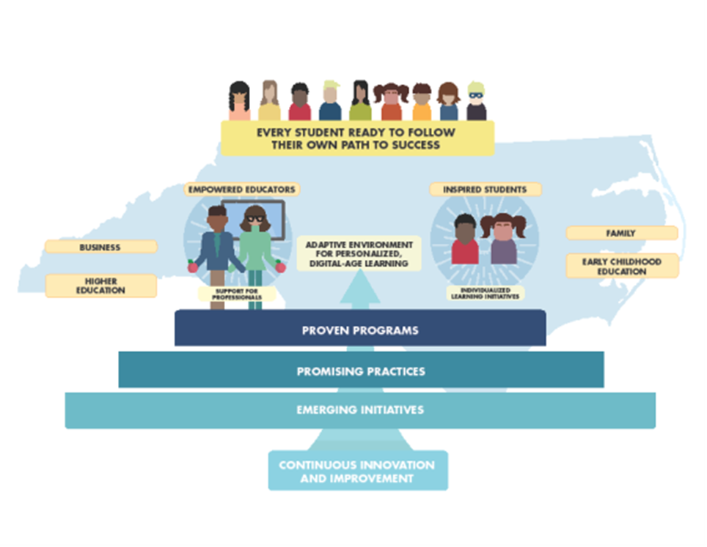
Theory of Action

Slide 4
What is Personalized Learning? What are some best practices?

Slide 5
Notes:
Please let me know if you have any questions!

Slide 6
School Performance Grades
Every Student Succeeds Act (ESSA) Accountability Model
Accountability Indicators legislated by the NC General Assembly
Includes separate grades for ELA/Reading and Mathematics for Elementary and Middle
Includes grades for reported subgroups
Major ethnic groups, Students with Disabilities, English Learners, and Economically Disadvantaged
Notes:
Please let me know if you have any questions!

Slide 7
Accountability Model
Academic Achievement Indicators
ELA/Reading and Mathematics
Mathematics includes 3–8 EOG and NC Math 1 for grade 8
Achievement (Level 3 and above)
Other Academic Indicator: Science (Gr 5/Gr 8)
English Learners’ Progress
School Quality or Student Success Indicator
Growth (ELA/Reading, Mathematics, and Science)
Note: The 15-point scale will continue for 2016–17, 2017–18, and the 2018–19 school years
Notes:
Please let me know if you have any questions!

Slide 8
School Performance Grades/ESSA: High Schools
Academic Achievement Indicators
English II and NC Math 1 or NC Math 3
Achievement (Level 3 and above)
Growth (English II, NC Math 1 or NC Math 3)
Four-year Cohort Graduation Rate
English Learners’ Progress
School Quality or Student Success Indicators
Math Course Rigor
ACT
ACT WorkKeys
Biology
Notes:
Please let me know if you have any questions!

Slide 9
Minimum N
Minimum N for Accountability Model = 30
If a school does not have 30 scores/data points in an accountability indicator (ELA/reading scores, math scores, students in Cohort Graduation Rate, English Learners for English Learners’ Progress, etc.), the data are not included in the accountability model calculation. By default, the omitted values are redistributed to the other indicators.
Minimum N for Reporting on School Report Cards = 10

Slide 10
Outcomes
In addition to School Performance Grades for All Students each subgroup, and ELA/reading and mathematics for grade 3–8 schools, the score from the accountability model will meaningfully differentiate schools for identification of
Comprehensive Support and Improvement Schools (CSI)
Targeted Support and Improvement Schools (TSI)

Slide 11
95% Participation Rule in ESSA
States must annually measure the achievement of not less that 95 percent of all students, and 95 percent of all students in each subgroup of students, who are enrolled in public schools on the assessments.
For purpose of measuring, calculating and reporting….. Include in the denominator the greater of
95 percent of all students (or 95 percent of the subgroup); or
the number of students participating in the assessments

Slide 12
Cohort Graduation Rate (CGR)
Four Year Rate
Included in accountability model
Five Year Rate
Reported but not included in accountability model
Students who exit an identification (ELs, Students with Disabilities) after the 9th grade will be included in the subgroup for the disaggregated CGR reports
Example: A ninth grade student identified as English Learner who exits prior to the cohort’s graduation year will be included in the English Learners’ subgroup for cohort graduation
This rule does not apply to the other subgroups
Notes:
Please let me know if you have any questions!

Slide 13
Cohort Graduation Rate (CGR)
Early Colleges: Will continue to treat five-year as the Standard and six-year as the Extended (aligns with four-year and five-year)
Students who transfer to a school or an LEA within the four years of the cohort
No longer will be allowed to remove students who are off-track from the graduation cohort
Will continue to attribute the student to the school most recently attended, not the school the student attended the longest.
Alternative schools: either ALL students are returned to sending school or none
Notes:
Please let me know if you have any questions!

Slide 14
Comprehensive Support and Improvement (CSI)
Definition
Lowest performing 5% of Title I schools based on index score
Lowest performing high schools based on graduation rate <66.7% (irrespective of Title I status)
Identification
First identified 2018–19 based on 2017–18 data
Identified every 3 years
Exit criteria applied at the end of the 4-year period (year 1 is considered a “planning” year)
Services from the SEA
North Carolina Comprehensive Needs Assessment
Continuous improvement support through NCStar Coaching Comments
Direct coaching services
Differentiated support through customized professional development and implementation and resource monitoring
Notes:
Please let me know if you have any questions!

Slide 15
Targeted Support and Improvement (TSI)
TSI-Consistently Underperforming Subgroups | TSI- Additional Support- Subgroup underperforming “on its own”
Includes all schools not just Title I | Identification based on underperforming subgroups compared to CSI schools
“Consistently” defined as most recent school year and 2 previous school years | Based on most current school year and 2 previous school years
Identified annually beginning 2019–20 with just two years of data | First identified 2021–22 (Based on performance and growth in 2018–19, 2019–20, and 2020–21)
Will seek waiver from USED | Identified every 3 years
THEN
Support for improvement in all TSI schools is the responsibility of the LEA
Title I schools not exiting must be identified as CSI schools
First applied in 2024–25 based on performance in 2021–22, 2022–23, 2023–24
Notes:
Please let me know if you have any questions!

