Slide 1
MTSS The Invisible Reach
Amy Jablonski: Director, Integrated Academic and Behavior Systems

Slide 2
Topic 1
Common Understanding:
Your Multi-Tiered System of Support Is Already There!
Topic 2
School Culture and Beliefs That Exist and Support MTSS

Slide 3
Topic 1
Common Understanding

Slide 4
sys•tem
noun
a set of principles or procedures according to which something is done; an organized scheme or method.
The system, itself,
(the set of principles),
is not what you see

Slide 5
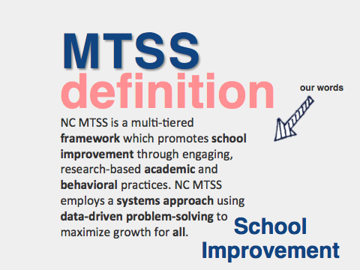

Slide 8
What Does MTSS Look Like?
Insert your image here

Slide 9
3 Themes of Successful MTSS
Linking the Work of PLCs
Engaging the Staff Through Dialogue
Persevering in the Face of Set Backs
Grit Perseverance Problem Solving
invisible
Notes:
When looking across schools that were successfully engaged in building an MTSS these 3 themes emerged:
1. Linking the work to the PLC’s
2. Engaging Staff in Dialogue Throughout the Implementation
3. Persevering in the Face of Setbacks
– Grit
-Perseverance
– Problem Solving

Slide 10
Leadership: It’s not a question of “Who is he/she?”
Notes:
Expand on the PLC theme – leadership becomes “us”
Within an MTSS, when we consider Leadership, it’s not thought of as an individual

Slide 11
Leadership: It’s a question of, “Who are they?”
Notes:
Rather - leadership is baked into the DNA of the school - we can’t depend on a single individual to lead this work - definitely a team approach
Have participants rate where they currently would rate 1-3 their school on this component (1= we’ve got a lot of work to do 3= this is a real strength) with a partner. Debrief

Slide 12
MTSS Should Make the Difficult Job of
Teaching Easier AND Increase Student Achievement
cc: Hindrik S - https://www.flickr.com/photos/63991153@N00
Notes:
This statement should be in the forefront of everything we do. If this isn’t true - we need to closely examine our current plans for building this infrastructure.

Slide 13
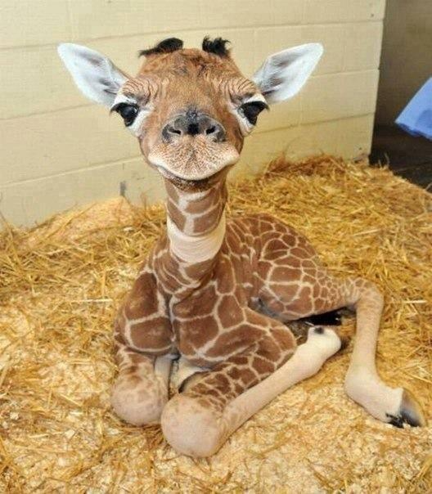
Our goal is to have
teachers
FEWER
do
things
BETTER

Slide 14
This is about identifying and defining what’s working really well in our building. We plan our support around these things in order to scale up these practices so that all students benefit.
You guys said it best

Slide 15
Topic 2
School Culture and Beliefs That Exist and Support MTSS

Slide 16
Dialogue, not monologue.
Shaping culture requires conversations rather than presentations.
School leaders who have engaged in this work didn’t make PowerPoint presentations on systematic intervention and extension before plunging ahead.
They linked the idea to a larger purpose.
They stressed why the system was needed before delving into how it would operate, and encouraged feedback from staff.

Slide 17
MTSS is not a schedule.
Creating a schedule is math
It’s the thinking behind the schedule: assumptions, beliefs and expectations (all invisible) that make a schedule so powerful
No schedule has the power to change the culture of a school

Slide 18
Notes:
SLIDES 10 – 14: we address the beliefs that are essential to the underpinning culture that is essential to this work
Quickly go through the next set of slides and explain that these beliefs lay the foundation for the more concrete steps we take to develop a multi-tiered system of support.

Slide 20
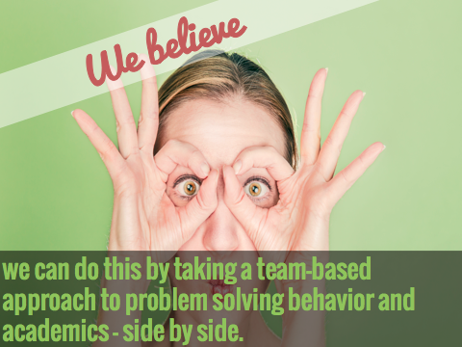
Notes:
A team-based problem-solving approach is the backbone to this school improvement framework.

Slide 21
Questions
Thank you

