Slide 1
Race, Trauma and Educational Opportunity
Keith Poston, President & Executive Director
James E. Ford, Program Director
Public School Forum of North Carolina

Slide 2
Study Group XVI Overview
Kicked off in October 2015 – Expanding Educational Opportunity in NC
Divided work in three committees – Racial Equity, Trauma & Learning, Low Performing Schools
176 committee members; 327 members and guests attended one or more committee meetings.
Attendees represent diverse backgrounds and perspectives (teachers, principals, legislators, superintendents, members of local school boards, business leaders, researchers, and other education professionals and advocates)
Completed work Summer of 2016 and released final report and recommendations in October 2016.

Slide 3
Trauma & Learning

Slide 4
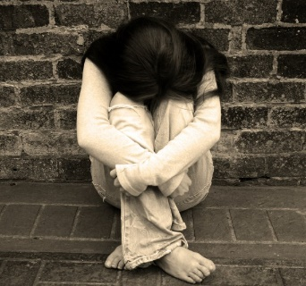
What is Trauma?
Trauma may be a response resulting from:
a one-time event OR
a chronic situation
Trauma can be the result of a number of categories of events such as:
Poverty/homelessness/lack of basic needs
Exposure to violence
Physical, sexual, or emotional maltreatment
Chronic neglect
Caregiver substance abuse or mental illness
Loss of caregiver (e.g., incarceration, custody change, death, parents serving overseas)

Slide 5
What is Trauma?
“Trauma is not an event itself, but rather a response to a stressful experience in which a person’s ability to cope is dramatically undermined”
Cole, S.F., O’Brien, J.G., Gadd, M.G., Ristuccia, J., Wallace, D.L., Gregory, M. (2005). Helping Traumatized Children Learn. Boston, MA: Massachusetts Advocates for Children, pp. 18.
Notes:
Many people think of trauma as the actual event itself – but researchers in this field define trauma as this
The reason is that people respond differently to the same event – siblings for example who experience the same event often have very different reactions to it

Slide 6
What are ACEs?
ACEs: Adverse Childhood Experiences
In 1995-1997, the largest study ever conducted on ACEs was done by the CDC and Kaiser-Permanente in California and included over 17,000 participants
The ACE Questionnaire includes 10 questions about 10 different adverse childhood experiences
https://www.cdc.gov/violenceprevention/acestudy/about.html
Notes:
It is interesting to note that this study was conducted on privately insured patients – mostly middle class

Slide 7
What did the ACE study find?
Out of the over 17,000 participants:
64% reported at least ONE ACE
26% reported ONE ACE
16% reported TWO ACEs
9.5% reported THREE ACEs
12.4% reported FOUR OR MORE ACEs
https://www.cdc.gov/violenceprevention/acestudy/about.html

Slide 8
Impacts of ACEs / Trauma Exposure

Slide 9
What is the impact of trauma and toxic stress?
Toxic stress is caused by prolonged or pronounced stress that overwhelms children’s skills or support
This causes children to go into “survival mode” or remain in a state of “stress response”
Being in this state on a regular basis actually alters the chemical and neurological events in a child’s brain

Slide 10
Chemical Reactions in the Brain
When a child experiences toxic stress:
Stress hormones (such as cortisol) are released and remain at high levels
This causes chemically toxic effects on brain regions involved in problem solving and decision-making
This toxic chemical reaction enhances functioning in emotional parts of the brain that respond instinctively to threat
Notes:
Stress hormones/chemicals flooding the brain in high amounts have two impacts:
-toxic effects on parts of the brain that are needed for learning – affecting problem-solving and decision-making
-toxic effects on parts of the brain that control emotions causing enhanced and dysregulated emotions in the part of the brain that responds to stress and threat

Slide 11
Brain Development
“Downstairs Brain” – Limbic System that controls:
Arousal
Emotions
The body’s physical response to stress (fight, flight, freeze)
When the “downstairs brain” is continually working to respond to stress and danger, it is hard for a child to switch to using parts of the brain needed for academic learning
“Upstairs Brain” – Prefrontal Cortex that controls functions needed for learning:
Ability to think and reason
Ability to take in new information
Memory
Ability to make decisions calmly
Ability to focus attention
Impulse control
Souers, K. & Hall, P. (2016). Fostering Resilient Learners. Alexandria, VA: ASCD.
Notes:
What happens to the brain when a child is constantly in “survival mode” due to trauma?
This becomes their norm even when they are not actually in danger
This causes a child to remain in their “downstairs brain,” constantly hyper-aroused with highly emotional, dysregulated responses to their surroundings, even when they are not in danger
The “downstairs brain” becomes more developed than the “upstairs brain” because it is the part used the most

Slide 12
Think about a time…
Have you ever been driving and focused on one thought – maybe your grocery list, what to cook for dinner, your first to-do item at work that day – and all of a sudden someone cuts you off or you have to suddenly slam on your brakes?
What does your mind do in that moment?
What does your body do in that moment?
Are you able to easily go back to the task you were originally thinking about?
This is how children with trauma may feel ALL the time.
Notes:
This is a small stress example – think about some of the trauma experiences we talked about earlier like physical abuse and the level of stress a child feels under that type of trauma. The impacts in these moments can be:
-impacts on language, logic and reasoning
-impacts on emotion and memory
-impacts on heart rate, digestions, immune system

Slide 13
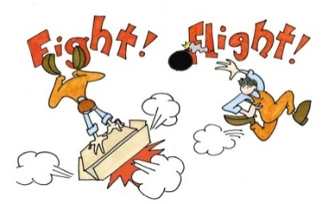
Fight, Flight, Freeze Response
The limbic system (“downstairs brain”) lets the body know when it is in danger and tells it to respond in one of three ways:
Fight: verbal and physical aggression or defiance
Flight: instinct to run and escape the danger
Freeze: wanting to shut down, withdraw, or become invisible
In normal situations, the limbic system keeps us safe, but for a child with trauma, this can become a constant state of being for them
These three responses are seen in a wide range of behaviors in kids
How have you seen the fight, flight, or freeze response
in children in your classes?
Notes:
When in danger, the body responds in one of these ways
The danger response from the body is a good thing because it keeps us safe but for kids with trauma, this becomes a constant state of being for them, even when they are not in danger – because of triggers or because of how their brain has been altered and so it is not good in that regard
Discussion – have them answer the last question out loud

Slide 14
What Does This Look Like in Schools?

Slide 15
Impact of Trauma is Seen in:
Learning & Academic Performance
Classroom Behavior
Relationships – peers/teachers

Slide 16
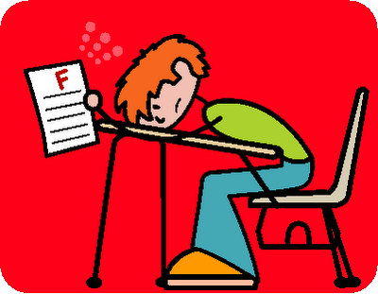
Impacts on the Whole School
Students with trauma have:
More office/discipline referrals
Increased suspension and expulsion rates
Lower academic performance – lower test scores
Higher retention rates
Poorer attendance and tardiness rates

Slide 17
NC Resilience & Learning Project: How it will work
Two key components:
Professional Development:
Training for the entire staff school-wide (should include ANY school staff who interact with students)
More in-depth training for the Resilience Team
Resilience Team:
A team within each school that will meet bi-weekly throughout the year to identify areas of urgency and work through a focused action planning process to create strategies that will make your school trauma-sensitive

Slide 18
How we can start: Shifting our view
Promote WHOLE school WHOLE child approach that is a total culture shift within the school – looking at a child thinking “What happened to you?” instead of “What is wrong with you?”
Traditional View
Impulsive
Aggressive/Defiant
Withdrawn/”unmotivated”
Over-reacting
ADHD
Reaction: STUDENT NEEDS TO BE PUNISHED
Trauma-informed View
Difficulty regulating emotions
Trauma response triggered, trying to gain control and find safety
Afraid, overwhelmed, world is a dangerous place
Seeking to get needs met
Lacking necessary skills
Reaction: STUDENT NEEDS SKILLS AND SUPPORT

Slide 19
Do Trauma-Sensitive Schools Matter?

Slide 20
Early Findings on Trauma-Sensitive Schools
Decrease in:
Student depression symptoms
Behavioral outcomes after 1 year:
Suspension rates by 30-90%
Office referral rates by 20-44%
Incidents of physical aggression by 43%
Behavioral outcomes after 5 years:
Suspension rates by 95%
Dorado, et al (2016) & Stevens (2012)
Notes:
Research is limited but some other models have shown positive outcomes

Slide 21
Early Findings on Trauma-Sensitive Schools
Increase in:
Student self-esteem
Academic outcomes:
Students’ ability to learn by 28%
Student time on task while in class by 27%
School attendance rate by 34%
Test scores
Dorado, et al (2016) & Stevens (2012)
Notes:
Research is limited but some other models have shown positive outcomes

Slide 22
Racial Equity in NC Public Schools: Where Are We Now

Slide 23
Qualifying the Meaning of Equity

Slide 24
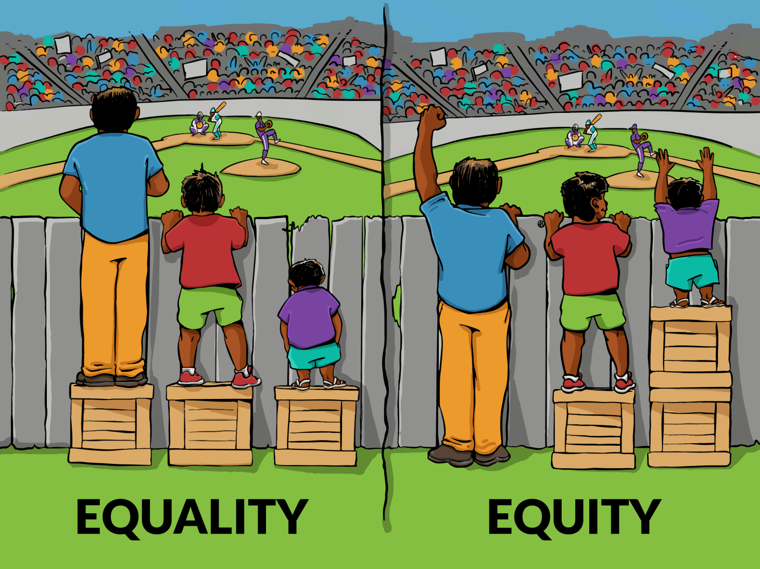
Understanding Equity

Slide 25
Race Still Matters

Slide 26
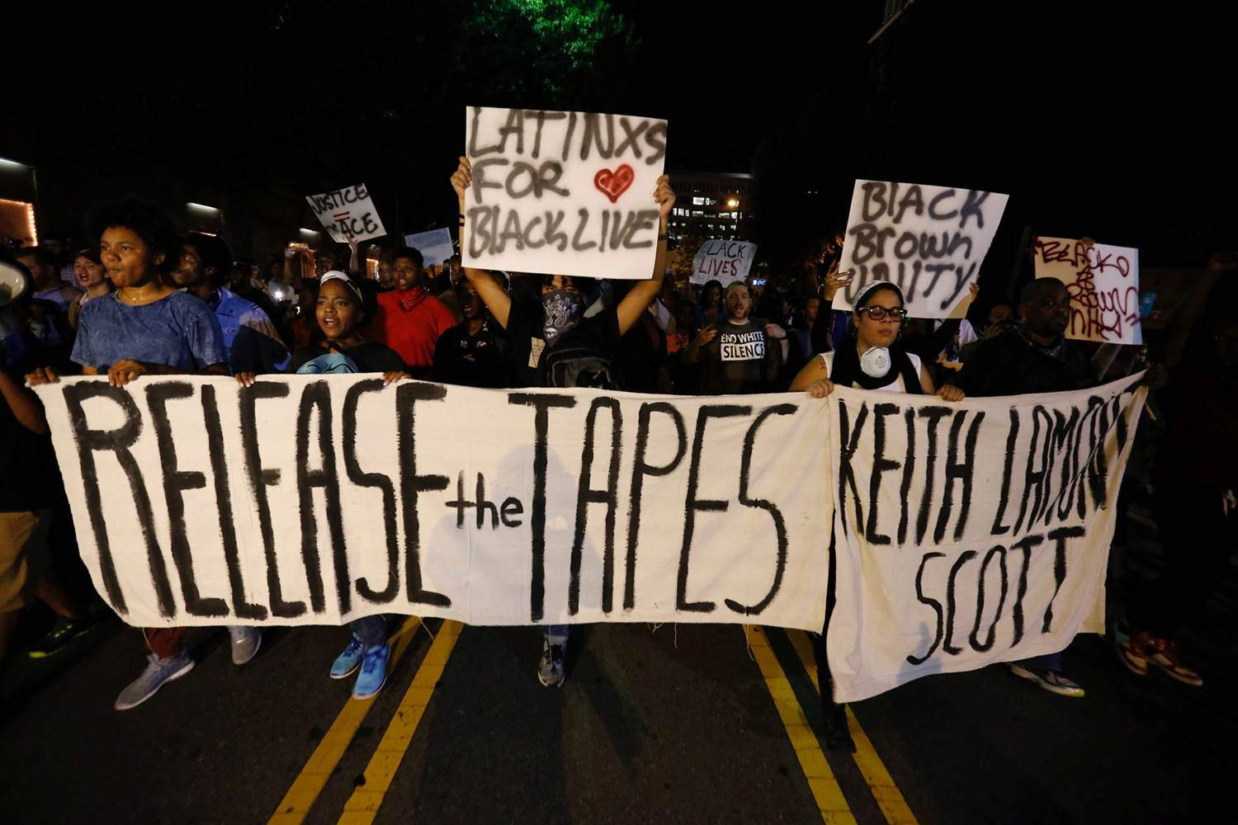
From Charlotte to Charlottesville

Slide 27
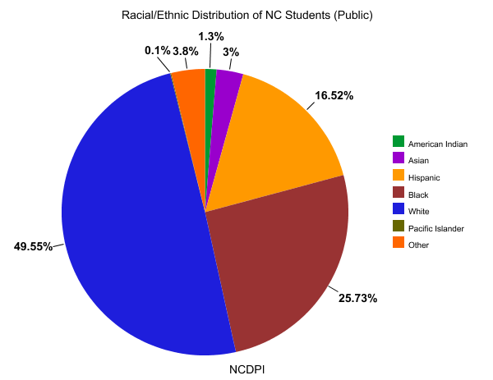

Slide 28
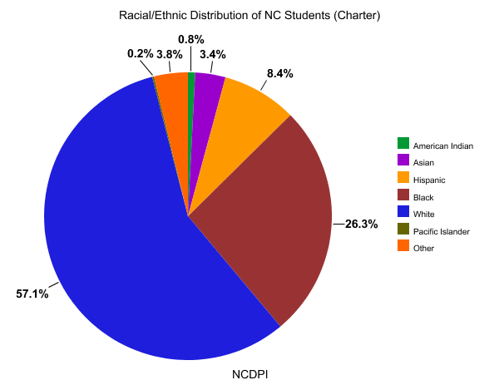

Slide 29
Qualifying Definitions
Race – socially-constructed classification of humans according to some physical features (eg; skin color, hair texture, body type, etc.).
Racism – (1) any individual or systemic belief, attitude, action or inaction, which grants or denies groups access and/or opportunity based on their race. (2) a pattern of social institutions — such as governmental organizations, schools, banks, and courts of law — giving inequitable treatment to a group of people based on their race.
Implicit Racial Bias - refers to the attitudes or stereotypes based on patterns and associations about a racial group that affect our understanding, actions, and decisions in an unconscious manner.
Disproportionality – disproportionate representation – over or under - of a given population. (eg; race, ethnicity, Socioeconomic Status, nationality, Limited English Proficiency, gender, etc.)
Racial Disparity – noticeably unjust or unfair outcomes based on race when individuals or groups are similarly-situated
Disparate Impact - a facially neutral policy or practice has an unjustifiable effect of discriminating on the basis of race, color, national origin, gender, or disability.

Slide 30
Racial Equity
Resegregation (Public & Charter)
Opportunity Gap
Discipline Disparities
Overrepresentation in Special Education
Access to Rigorous Courses and Programs
Diversity in Teaching
Culturally Responsive Pedagogy
Do the national trends of racial inequity persist in North Carolina Public Schools?

Slide 31
Resegregation
Brown v. Board of Education (1954), North Carolina has several districts that have since resegregated
Abandonment of desegregation efforts in favor of “neighborhood school” models has once again made schools more racially identifiable, due in part to residential segregation
For residents living in majority Hispanic and African American census blocks, the chance of their children attending racially-identifiable, high poverty, or low-performing schools is dramatically higher than for those in majority white census block

Slide 32
Resegregation
Over the past two decades, the share of Black and Hispanic students attending majority-minority and intensely-segregated schools statewide has grown significantly.
Resegregation has appeared in other counties as well, including Guilford, Forsyth, Pitt, Halifax, and Harnett
North Carolina charters are increasing the extent to which the overall system of public education in the state is racially identifiable as well.
Roughly two-thirds of all charter schools in the state are either disproportionately white or disproportionately students of color.

Slide 33
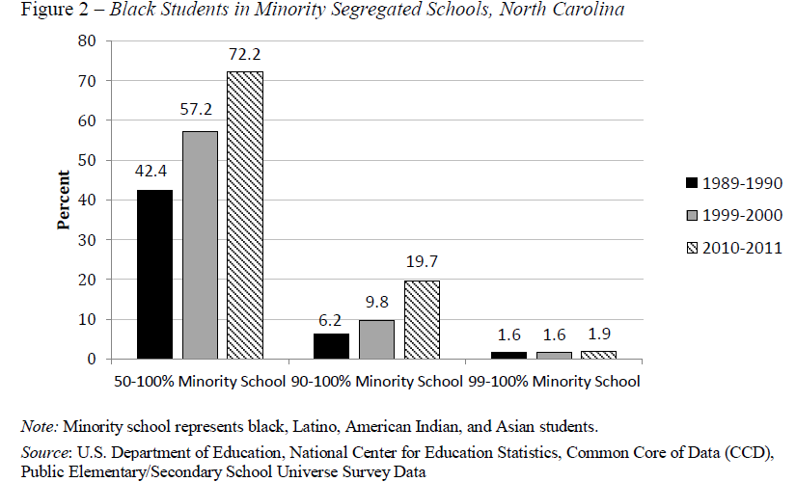
Trend in Black Student Segregation
Source: Segregation Again: North Carolina's Transition From Leading Desegregation to then Accepting Segregation

Slide 34
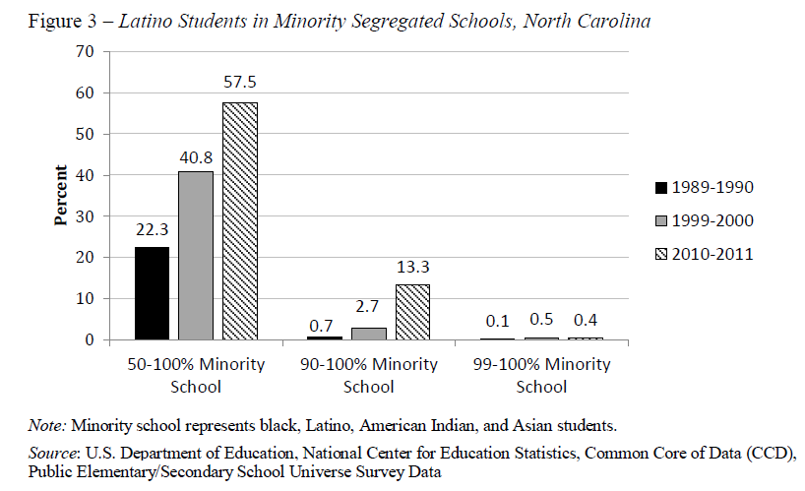
Trend in Latino Student Segregation
Source: Segregation Again: North Carolina's Transition From Leading Desegregation to then Accepting Segregation

Slide 35
Discipline Disparities
Students of color in North Carolina schools have significantly higher rates of both short- and long-term suspensions than their white counterparts.
The state has lowered the overall rates of suspension and expulsions over the past several years. What has not changed, however, is the disproportionate representation of students of color in disciplinary actions
Black students in particular are as much as four-times as likely to receive short-term suspensions as their white counterparts, with similar gaps in long-term suspension data.
American Indians are suspended at rate three-and-a-half-times more.

Slide 36
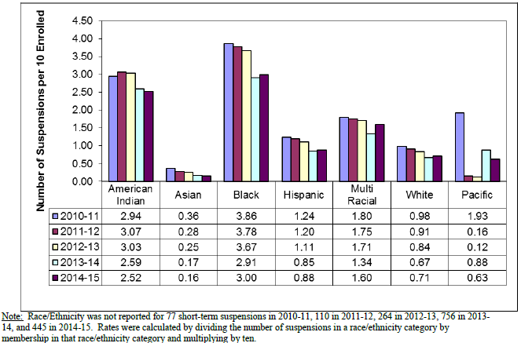
Rate of Short Term Suspensions by Race
Source: North Carolina Department of Public Instruction

Slide 37
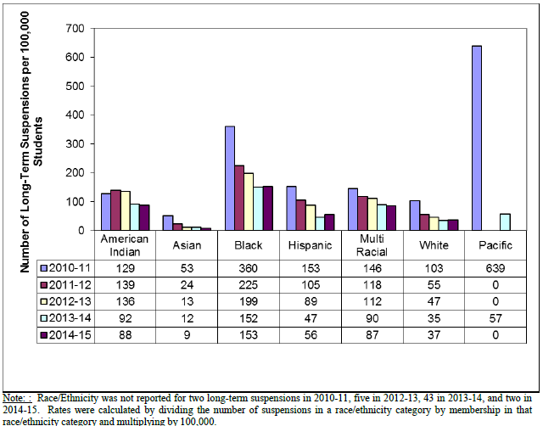
Rate of Long Term Suspension by Race
Source: North Carolina Department of Public Instruction

Slide 38
Subjective vs. Objective Offenses

Slide 39
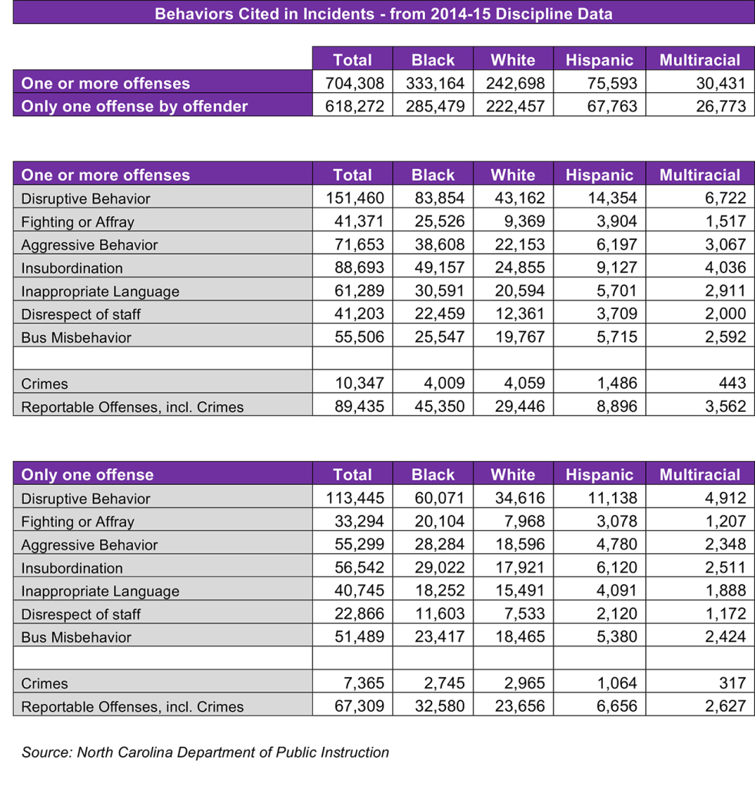

Slide 40
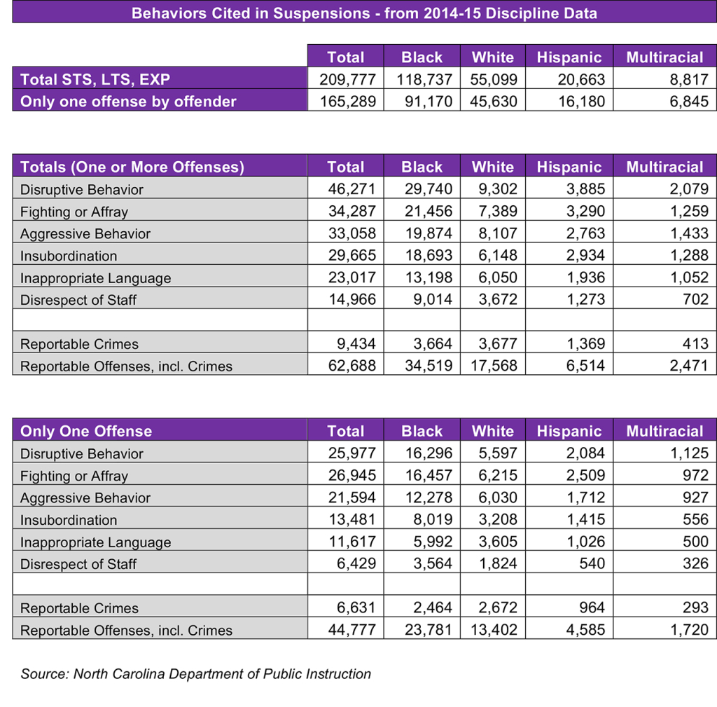

Slide 41
Opportunity Gap
In nearly every educational metric, from cohort graduation rates to college and career readiness, the majority of students of color in North Carolina underperform their white counterparts.
The trend holds even when one controls for economic disadvantage, exceptional children’s status, and limited English proficiency. This is commonly called the “achievement gap,” but is perhaps better termed an “opportunity gap.”
A student is at a decided disadvantage if he lives in poverty, lacks stable housing or adequate healthcare, experiences food insecurity, is exposed to adverse childhood experiences, has limited english proficiency, or is an undocumented immigrant. Students of color are overrepresented in these categories, all of which have deleterious effects on academic achievement

Slide 42
Overrepresentation in Special Education
In North Carolina, all racial subgroups remain relatively proportionately represented, with the exception of African Americans, who make up 26 percent of all public schools students yet comprise 32 percent of all school-aged children with disabilities.
Specific areas where they are most overrepresented are: intellectual disability (45%), emotional disturbance (44%), developmental delay (34%), and specific learning disability (32%).
Research in this area suggests that overrepresentation in these categories belies misdiagnosis rooted in cultural bias and misunderstanding.

Slide 43
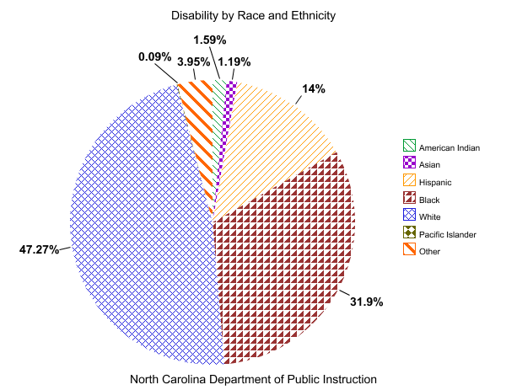
Overrepresentation in Special Education

Slide 44
Access to Rigorous Courses & Programs
Students of color are underrepresented in the most rigorous courses and programs offered in North Carolina schools, including Advanced Placement (AP), International Baccalaureate (IB), and Academically or Intellectually Gifted (AIG)
But a concerted effort has been made to increase AP subgroup enrollment and test-taking in North Carolina. Student participation in AP courses among American Indian students increased by 45 percent last year
In AIG identification, disparities persist, with Black and Hispanic students the most dramatically underidentified groups, both around 5 percent

Slide 45
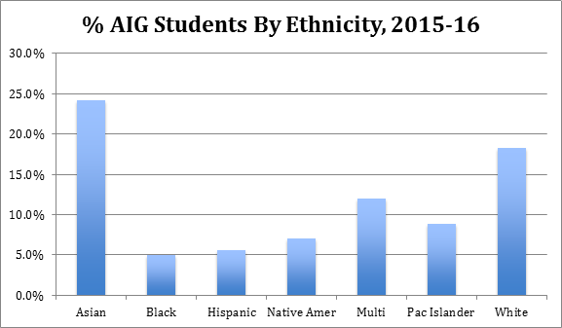
Racial Distribution of Academically & Intellectually Gifted Students
Source: North Carolina Department of Public Instruction

Slide 46
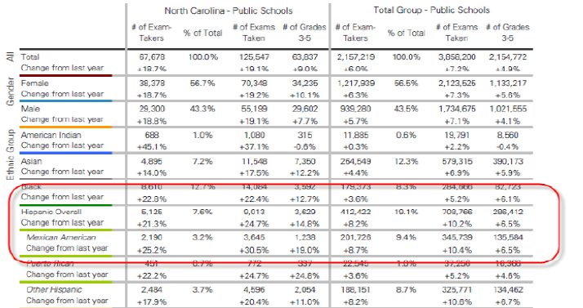
AP Racial Participation Rates and Gains

Slide 47
Diversity in Teaching
In North Carolina, the vast majority of the teaching force is white (84%).
This is a tremendous mismatch with an increasingly diverse student population that is half non-white. For the majority of teachers in the state it is likely that they will teach students who do not come from the same racial or ethnic background.
Research has indicated that having teachers of color reduces the likelihood of suspension for students of color, leads to increased achievement, and increases identification as AIG.

Slide 48
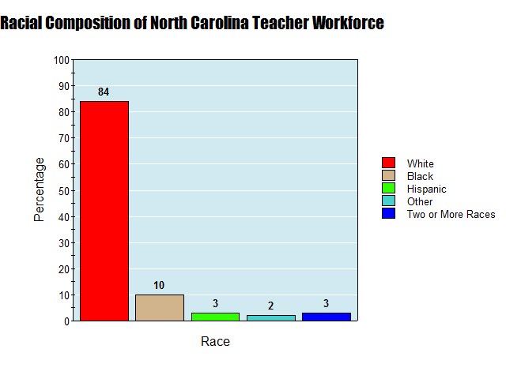
*Total is greater than 100 due to those identifying ethnically as Hispanic
Source: Center for American Progress

Slide 49
Culturally Responsive Pedagogy
Teachers must be able to relate to the students they serve. Whatever their background, teachers need to understand their students both as individuals and as representatives of their communities.
Unfortunately, recent North Carolina Teacher Effectiveness ratings for teachers instructing students of color have been dismal
Approaches to teaching that honor students’ cultural customs and traditions have been shown to increase achievement.
Underpinning many of the data disparities related to culturally-responsive pedagogy is the presence of implicit racial bias.

Slide 50
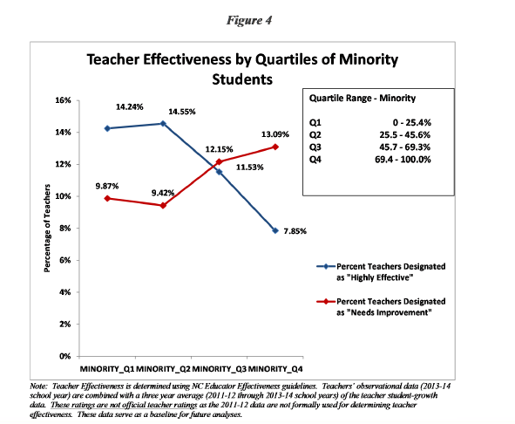

Slide 51
NC Racial Equity Consortium
Vision Statement: We are a statewide collaborative that will eliminate race as the predictor of educational outcomes for students in North Carolina.
Comprised of school districts, community advocates, education researchers and consultants.
Fee-based membership
Work collaboratively to dismantle systems and structures that keep racial achievements gaps in place across NC schools.
Four main areas of intervention: (1) Strategic Planning, (2) Community Engagement, (3) Convening and (4) Professional Development

Slide 52
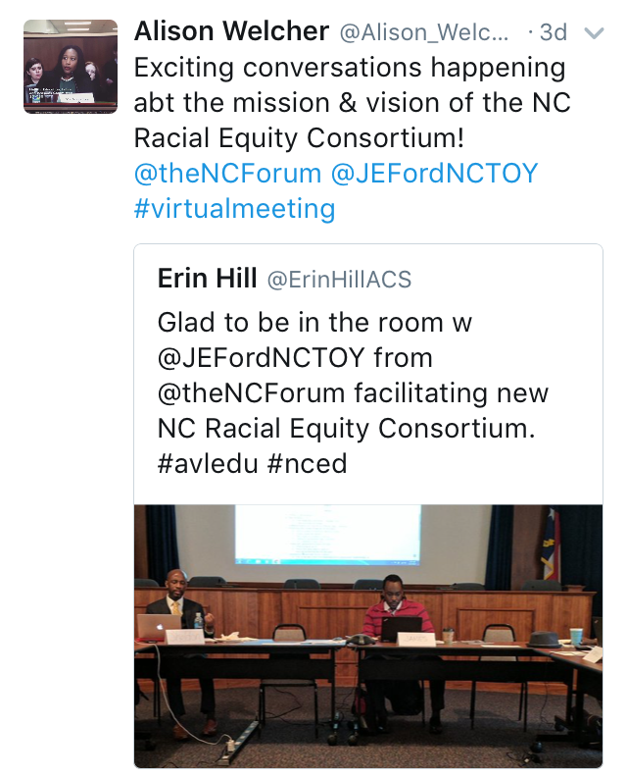
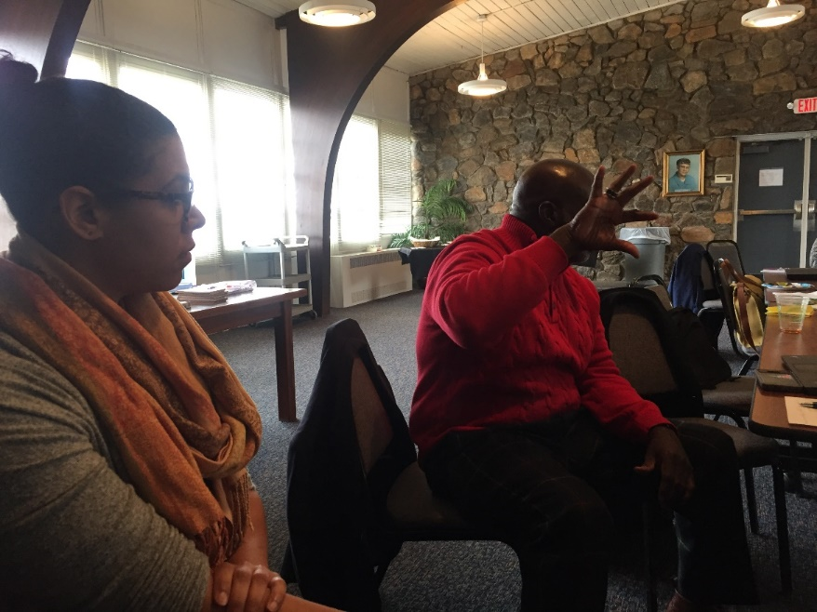
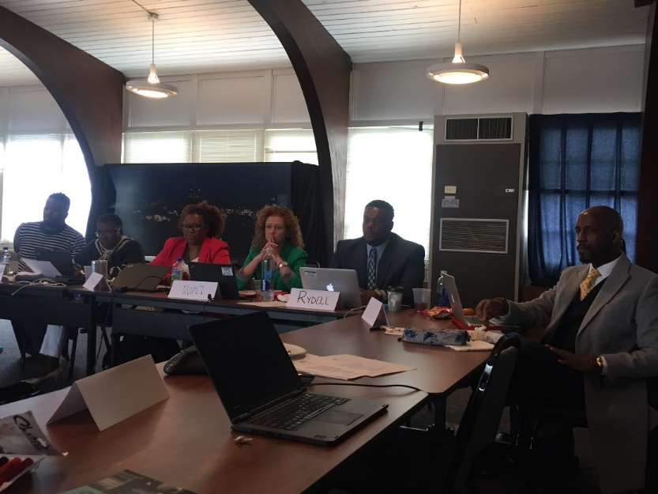

Slide 53
Strategic Planning
Formation of a Design Team or Advisory Board (met 4x)
6 District Equity Officers
2 School Board Members
1 Superintendent
1 Education Attorney
Several researchers and consultants
Building a framework for racial equity work in NC

Slide 54
Community Engagement
Assessing racial climate in communities utilizing surveys
Bringing awareness to the racial inequities in the school system (i.e. hosting town halls and listening sessions)
Organizing stakeholders using collective voice
Using feedback to guide the Consortium and hold it accountable to communities.

Slide 55
Convening
Holding an annual Racial Equity Symposium, featuring premiere speakers, sessions and workshops explicating dealing with the intersection of race and education.
In addition, mini-conferences that allow educators to collaborate peer-to-peer across districts while focused on fixing racial disparities in outcomes. (i.e. superintendents, admins, teachers, board members, students)

Slide 56
Professional Development
Providing access to research and best practices in the area of racial equity
A clearing house for expert trainers and consultants that work more intensely with districts and schools as service providers
Information sharing and resource hub for those looking to learn more.

Slide 57
Considering Racial Equity + Trauma

Slide 58
How do we see all of this through a racial equity lens?
As we think about trauma impacts and trauma-informed practices, also consider the issues with a racial equity lens.
Disproportionality of trauma by race
How do we incorporate equity into the conversation about trauma and resiliency?
As we move forward in looking at areas of urgencies and strategizing, how do we ensure that we are creating trauma-sensitive practices that are also racially equitable?
Notes:
Research is limited – but there are some studies that show disproportionality of trauma by race – stat from article – one study did find that US born families AND immigrant families in three racial categories (Hispanic, Black, White) showed disparities – the black and Hispanic children were exposed more to ACEs than the white children – this study also looked at SES and found disparities in income level and ACEs as well
Read questions as food for thought – just pause and let them ponder, not answer outloud

Slide 59
Two Strikes: Race and the Disciplining of Young Students (Ebenhardt & Okonfura, 2015)
57 K-12 Teachers
Teachers were given an adapted school referral records of an middle school student
The identical records were manipulated by using stereotypical black names (Darnel or Deshawn) vs. white names (Greg or Jake).
After reading infractions, they were asked to rate how irritated they were and how severely the student should be punished.
After the second round, black students were rated more severely.

