Slide 1

Strategic Human Capital Session
December 18, 2018

Slide 2

Who Are We?
Urban Schools Human Capital Academy, Founded 2011
We develop, support, and network human capital leaders in schools, districts, and states to drive measurable improvements
in teacher and principal quality
Best People
Knowing Your Schools
Best Results
Customer Service
=
Data and Information
Best Decisions
Notes:
Betsy

Slide 3
Why Do We Do This Work?
Human Capital is the Key Lever in Schools
1/3 of all HS graduates meet minimum college readiness criteria
Less than ¼ of African American graduates college ready
Only 20% of Latino graduates college ready
Effectiveness Matters
Difference between 3 consecutive yrs of effective teachers vs. ineffective =
52 percentage points
Money Matters
~85% of school systems’ budgets = PEOPLE
Notes:
Betsy
SOURCES
Marzano, Waters & McNulty. “School leadership that works: From research to results.” Association for Supervision and Curriculum Development (2005)
Nye, Konstantopoulos and Hedges. “How Large are Teacher Effects?” Educational Evaluation and Policy Analysis (2004)
Educational Research Service, Alexandria, VA
Sanders & Rivers. “Cumulative and Residual Effects of Teachers on Future Student Academic Achievement: Research Progress Report ” (1996)
Roderick, Nagaoka, & Coca. “College Readiness for All: The Challenge for Urban High Schools.” (2009)

Slide 4

Who is in the Network?
USHCA has worked with 30+ districts and 16 states
Seattle
Newburgh
Rochester
Boston
Cleveland
Pittsburgh
Philadelphia
Aurora
Montgomery County
Baltimore City
Denver
Indianapolis
Prince George’s County
Los Angeles
Jefferson
Fayette
Guilford
Tulsa
Charlotte-Mecklenburg
Oklahoma City
Shelby Co.
Atlanta
Duval
Alumni Districts
Current Districts
Spring
Seminole
Houston
Hillsborough
Osceola
Pinellas
Miami-Dade
Blue – Cohort 2 States
Green – Cohort 1 States
Little Rock
North Little Rock
Jacksonville North Pulaski
Pulaski County

Slide 5
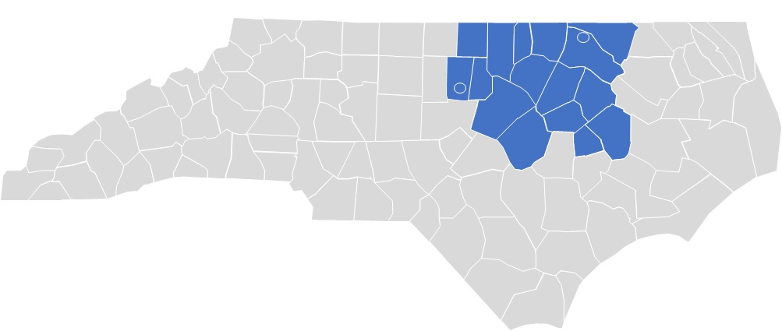
Who is in the Room?

Slide 6

The Itinerary
Welcome and Warm Up
Introduction to Strategic HR Work
Break
Review of the Assess Breakthrough Change Best Practices Framework
Lunch
Recruitment & Retention Best Practices
Data: The Foundations for Your Strategic Work
Summary & Feedback
Notes:
Betsy

Slide 7
Session Outcomes
Relevant, Practical Learning
By the end of this session you will be able to:
Define the “strategic” work of HR
Identify your most significant HC challenges, the root causes of the challenges and your data needs; these will be shared with DPI to inform their efforts to deliver meaningful district data and support
Review a framework of strategic Human Capital elements
Learn about recruitment and retention best practices and identify strategies your team could implement to strengthen your work in key areas
Network in cross-district teams, as well as team planning time.

Slide 8

Our Norms for Working Together
Put students first as we think about the work.
Tell your truth
Share your expertise, including “Wins” and “Losses”
Leave your title at the door and think enterprise-wide
Help us to figure out how to solve -- and not just identify -- the problems that we face (addressing and influencing)
Ask questions of us – and each other.
What is learned here, leaves here. Apply this to your own role.
Notes:
Katie

Slide 9

Warm Up
9
“Who was the best teacher you ever had and why?”
Notes:
Darlene

Slide 10
Intro to Strategic HR Work

Slide 11
Compliance vs. Strategic Work
A Delicate Balance
You have limited resources – time, money, etc.
What actions will have the most impact on your workforce quality?
There is a delicate balance between transactional and strategic work

Slide 12

Strategic or Not
Quiz

Slide 13
Strategic Human Capital Management
The collective and individual knowledge, skills and abilities available to apply to an organization’s goals*
USHCA’s 4 Principles of Strategic K-12 HC Work
Contributes to the quality of the workforce, especially teachers and principals
Aligns to instructional improvement needs
Builds capacity of line managers as HC leaders
Measures key indicators for continuous improvement
* Definition adapted from Teaching Talent: A Visionary Framework for Human Capital in Education

Slide 14
Pulse Check
Partner Discussion
Out of 100%, what’s the current balance of your work that is:
  Strategic?
  Compliance or transactional?
Do you feel like this is the right balance for you?
  Why or Why Not?

Slide 15
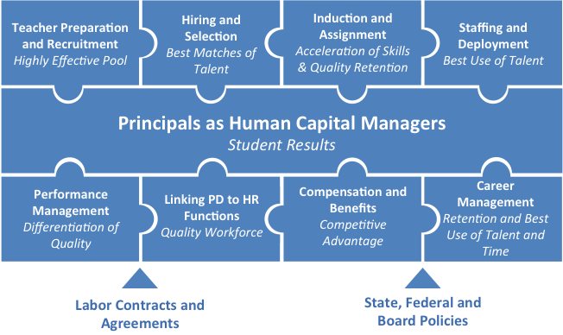
Puzzle Pieces
Components of The “Right” Work
Notes:
Ask all – who is your key customer – your key human capital manager?

Slide 16




Context that Influences “Right” Work
Unions/Labor Agreements
Budget
School Board
Influence
Federal, State, Local Policies
Notes:
Betsy

Slide 17
How Do You Know?
Assessing your HR/HC Functions – HC in Schools
1. 80% or more of Principals are supportive and complimentary of HR
2. Schools open with 100% vacancies filled
3. Evaluations reflect student achievement results and at least 10% of the lowest performing teachers should be exited or improved significantly
4. Teachers (especially low-performers) are not moved/forced placed from one school to another against the Principal's wishes
5. Principals have access to the applicant pool 24/7 and applicants have access to vacancies online 24/7
Notes:
Betsy
Have them assess at their table with a partner

Slide 18
How Do You Know?
Assessing your HR/HC Functions – HC Central Functions
6. Early contracts are offered in science, math, bilingual, special education or other critical shortage fields and 80% of hiring in those fields is completed by June 1.
7. Adding a new hire to payroll is done online and takes no more than 72 hours, start to finish.
8. Hiring process for new principals is finished by May and 100% of Superintendent/Assistant Superintendents/Principal Supervisors are pleased with the quality and quantity of principal applicants
9. Investigations of misconduct are completed quickly and efficiently
10. There is a well-publicized deadline by which teachers have to resign (June 1 is best practice), with consequences
Notes:
Betsy
Have them assess at their table with a partner. If there is time, ask the group for particularly strong practices to share.

Slide 19
Individual Reflection
Take A Moment
What is the single most strategic action you took this week?
What is one strategic action you might take next week?
Top Tip:
Consider: Is your action valuable to your key customer?
Further Learning:
Stop-Start-Continue – A Decision-Making Framework

Slide 20
Key Work – The ABC Tools
Summary

Slide 21
Content in Context
What is the most important or
“right” work to recruit and retain
teacher and principal leaders?
Key Work of HR – ABC Tools

Slide 22
What is the Key Work of HR?
The “Right” Work
A highly effective HR/HC function focuses on the right work:
          Work that makes a Principal’s job in finding and keeping great teaching talent for their school considerably easier
          Work that makes finding and keeping great principals considerably easier
The key work of HR is outlined in the Teacher and Principal Puzzle Pieces – and the related ABC Tools

Slide 23
What is the ABC Tool?
Diving Deeper into the Right Work of the Puzzle Pieces
USHCA created two separate but related Assess, Breakthrough, and Change (ABC) Tools – the Teacher ABC Tool and the Principal ABC Tool – that detail and measure HR’s functionality in the key work of HR
The ABC Tools align with the components of the Teacher and Principal Puzzle Pieces
Each component of the Teacher and Principals ABC Tools is backed by research, best practice, and measureable benchmarks that help district teams track current performance and improvements over time
ABC Tools are focused on the HR actions and activities most critical for improving teacher and principal quality
Notes:
Strategic or Not

Slide 24
Anatomy of the ABC Tools
Understanding the Graphic
Puzzle Piece Title – one key component of the “right” work
Assessments – Detail functionality in the lever from minimally to highly
Italicized Font Subtitle – what you can expect as a result if you’re highly functional in this area
Metrics – What to measure
Benchmark Metrics – Target/ Goal
Lever – Details key activities or actions HR should take
Notes:
Betsy

Slide 25


25

Slide 26
Why is This Important?
Key Work
HR often gets mired in transactional work with little impact on teacher and principal quality
There are best practices available to improve teacher and principal quality – HR teams don’t need to reinvent the wheel
HR’s contribution to workforce quality can and should be measured
Notes:
Strategic or Not

Slide 27
Keep in Mind
Things to Remember
The work of HR is to make a Principal’s and Principal Supervisor’s jobs in finding, deploying, and retaining great talent easier
HR should stop or streamline work with little impact on teacher and principal quality
Using data is essential in understanding HR’s strengths and gaps
The Puzzle Pieces and the ABC Tools provide a comprehensive review of HR’s key work with associated metrics
All team members should understand the key work – not just HR leaders
Notes:
Strategic or Not

Slide 28
Making Connections
Related Content
Teacher and Principal Puzzle Pieces
  Outlines, in a graphic format, the key work of HR
Stages & Priorities for Transforming HR/HC
  Stages and prioritizes the work of HR when confronted with limited staff and resources
Power Metrics
  Provides the top metrics HR/HC must measure and use to support and improve the quality of teachers, principals, and HR/HC
Key Levers for Accelerated HR Improvement Tool
  Provides a process to understand and identify the key HR work required to make progress

Slide 29
HRinED.org
It’s FREE!!!
Notes:
Craig

Slide 30
HC Challenges and their Root Causes
Identifying Barriers to Recruiting and Retaining Great Teachers and School Leaders
Table Activity – As a team, discuss your biggest challenge in recruitment and retention (if there is a barrier, name it and use data or numbers if you can) and write it on a post-it. Decide who will go to recruitment and who will go to retention for a cross-district discussion. When instructed, place your post-its on the charts that correspond with your district.
Group Activity – Read the “challenge” post-its and have a cross-district group discussion of the most significant challenge/barrier in Central Carolina and its root cause. (Keep asking “WHY?”) Write the challenge and its root cause on a separate piece of chart paper. Select someone from your group to share out.

Slide 31
HC Challenges and their Root Causes
Share Out
The four spokespeople summarize the discussion held in their group and share the challenge and root cause written by their group.
KEY POINT:
Effective human capital strategies in each district must be based on an accurate understanding of root causes and the local context.

Slide 32



Slide 33
Recruitment and Retention Best Practices

Slide 34
Warm Up
What brought you here?
What keeps you here?
Notes:
Darlene

Slide 35

Recruitment AND Retention
Two sides of the same coin
To address shortages and fill open vacancies, districts often focus primarily on recruitment
Without a focus of retention too, you are simply filling a “leaky bucket”
Districts must focus on building both great recruitment AND great retention functions to maximize efforts to get and keep highly effective employees
Notes:
HR and line managers share responsibility for retention.

Slide 36

Recruitment
The purpose of recruitment is to build a broad and highly effective pool of potential hires ready to meet your staffing needs

Slide 37
Recruitment
The purpose of recruitment is to build a broad and highly effective pool of potential hires ready to meet your staffing needs
Keeping Them Warm
Selecting the Best Fit
Building & Expanding the Pool
GET THE BEST Consistently

Slide 38
Building & Expanding Your Pool
Best Practices
Analyze your pipelines
Active vs. passive recruitment
Project vacancies early
Create a clear value proposition for best fit employees
Leverage active & passive pipelines to expand your pool
  Internal and external
  Employee referrals
  Local partnerships
  Seek diversity
Offer early contracts
Great website, social media, and easy-to-complete application
Screen In!
Notes:
Reactive vs. proactive

Slide 39
Keeping Them Warm
Cultivation Techniques
Candidate Experience
Best Practices
Differentiate your outreach; tier candidates
Schedule consistent communications; tell them where they stand; coordinate with hiring manager
Match candidates with district ambassadors
Host an event to network new hires – in person or virtually
Ask/ survey candidates for what they need from you
Communicate Often & in Personalized Ways

Slide 40
Recruitment & Selection
Measuring Your Success
POWER METRICS
Keeping Them Warm
Selecting the Best Fit
Building & Expanding the Pool
Enough applicants?
“Right” applicants?
GET THE BEST Consistently
Top choice?
Acceptances?
Effective employees?
Satisfied hiring managers?

Slide 41
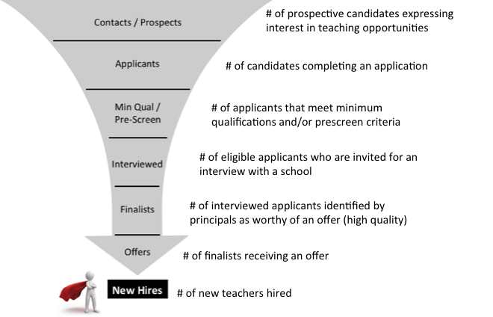
Analyzing Your Current Pipelines
How do we minimize “Leakage” in our recruitment bucket?

Slide 42
Analyzing Your Current Pipelines
How do we minimize “Leakage” in our recruitment bucket?
Are we losing candidates due to the application?
Are unqualified candidates entering the candidate pool?
Are we too strict?
Are we selecting the best candidates for interviews?
Are we identifying the best candidates for offers?
How are we getting to YES?

Slide 43
Individual Reflection
Take A Moment
What can you do with your hiring managers next week to improve your recruitment & selection process?
Top Tips:
Ask hiring managers & candidates for pain points in the process
Further Learning:
Analyzing Your Recruitment & Selection Processes for Missed Opportunities

Slide 44
What is Retention?
Keeping the Best Talent
Retention – the rate that all employees stay or remain in the district
Strategic Retention – keeping the top performers while simultaneously removing the weakest performers
Additional terms used to discuss retention*:
  Attrition or “Leavers”: Rate at which employees leave (resignations, retirements, terminations, etc.) the district or education altogether (“Leavers”)
  Migration or “Movers”: Rate at which employees move to jobs in other schools/offices within the district (“Movers”).
  Turnover: Includes both attrition and migration
*Ingersoll, 2001;Luekens, et al., 2004.
Notes:
Turnover can be good or bad

Slide 45
Primary Driver: Performance
Performance Drives WHO to Retain
Understand performance at the organization, network, school/department, and individual levels
Focus on keeping high performers – “Irreplaceables”
  Only about 20% of teachers are “Irreplaceables”
    Takes 11 hires to find one of comparable quality
Performance
Low | Average | High
Source: TNTP, 2012.
Notes:
TNTP. (2012). The Irreplaceables: Understanding the real retention crisis in America’s urban schools. New York City, NY.

Slide 46
Research Specific to Teachers
Be Proactive & Practice Strategic Retention
Top educators produce stronger gains for students
  Top teachers produce 5 to 6 more months of learning per year
  Top principals generate 2 to 7 more months of student learning gains
Low performers don’t always opt out
  Most ineffective teachers had 9+ years of experience and planned to stay for another decade
Data from TNTP’s The Irreplaceables
Notes:
https://www.thebalancecareers.com/the-high-cost-of-high-employee-turnover-2276010
Link to a turnvoer cost calculator: https://bonus.ly/cost-of-employee-turnover-calculator

Slide 47

Retention is Individual
No one-size-fits-all solution
Employee voice is important
Different people need different strategies

Slide 48
Mini Case Study
Two High Performers
What might it take to retain them?
Rockstar A
  45 years old
  Female
  African – American
  Prior career as a chemical engineer
  Career switcher
Rockstar B
  24 years old
  Male
  Caucasian
  Strong tech skills
  First job

Slide 49
Lenses for Understanding Retention
Insight into HOW to Retain Employees
Craft strategies at the school/ department & org levels
Turnover Type
Diversity
Gender
Experience
School Type
On-ramp
Generation
Movers | Leavers
Alt Cert | Trad Cert
Race | Language
Retention Lenses
High Needs | Low Needs
Male | Female
Millennial | Gen X | Boomer
New | Mid | Veteran
Subject
Shortage | Nonshortage

Slide 50

What We Know
Common Themes
Great employees are seeking:
Great leaders to work for
Growth in their profession
Recognition for quality work done
Meaningful compensation
Collaborative working environment
Perception of the leader has the greatest impact on whether s/he stays or goes
Source: Boyd, D., Grossman, P., Ing, M., Lankford, H., Loeb, S., & Wyckoff, J. 2009.

Slide 51
Retention
Best Practices
Understand the underlying reasons for turnover to focus on areas that are more controllable
  Cross district transfers/promotions vs. out of state relocations or career changes
Engage employee’s voices in retention strategies
Approach retention from top-down and bottom-up with district- and principal-based strategies
Recognize and celebrate excellence
Invest in meaningful and ongoing novice induction
Map individual retention with hiring managers

Slide 52
Self-Assessment
Bottom-line Recruitment & Retention Health Indicators
Consider the most recent school year:
Did you open school with zero vacancies in every school & department?
Were all hiring managers 100% satisfied with the quality and quantity of their applicant pool?
Did the district retain at least 90% of effective and highly effective employees?
If you answered No or I Don’t Know to any of these questions, there’s still work to do on recruitment & retention.

Slide 53
Data: The Foundations of Your Strategic HR Work

Slide 54
Why Is This Important?
Human Capital Data
“The most serious mistakes are not being made as a result of wrong answers. The truly dangerous thing is asking the wrong question.” – Peter Drucker
Data doesn’t lie – it objectively shows areas of strength and growth
Data shows the results of a district’s efforts – and can encourage a change in strategy, if needed
Measuring HR’s contribution and improvement to the workforce over time shows the impact of HR’s work on students

Slide 55
Leading with Data
First…
Know What Data Matters
Engage Stakeholders with Data
Build a Data-Driven Culture
Then…
In order to…
Notes:
Leading with Data
We have learned a great deal from working with districts over the years to become more data-driven, especially for human capital management.
While there are many bases to cover, we’ve distilled our learning into 3 key principles:
First, it is critical to know what data matters. This is about starting with the end in mind, and prioritizing the right human capital metrics that will form the basis of your team’s improvement work. When you start with a clear understanding of what you need the data for, the work of collecting and connecting mounds of data becomes straightforward.
Second, you must engage stakeholders with data. Human capital management systems and processes may be designed in certain central office teams, but it is the shared responsibility of the entire school system to manage talent – which is why it must become common practice to share timely data. As you will see across the program, principals are THE key human capital managers, so it is critical for HR to support them with meaningful data.
And third, where we see the first and second principles in play, it’s usually because there are concerted efforts to build a Data-Driven Culture. Much of this is in the team’s habits and beliefs around the use of data. This influences how and where they talk about data, how they plan, and how they think about organizing and developing their people.

Slide 56
Data Foundations
Power Metrics
Who are your effective employees? Need reliable, differentiated data on effectiveness levels
Which are your highest-needs schools and departments? Use student achievement data and/or human capital data (e.g. vacancies, retention rates) to identify schools most at risk.
How satisfied are HR’s key customers? Use surveys, focus groups and other feedback loops to understand how customers perceive support from HR.
Notes:
There are some assumptions we make with these power metrics.
Putting these foundations in place is hard but necessary to understand how you are supporting schools in your district.

Slide 57
Driving Questions
Key “Power” Metrics
How do you know if HR is meeting the needs of the district? Use data to answer 4 key questions.
GET THE BEST Consistently
Have we recruited the best? Do we have enough quality & quantity?
DEPLOY Deliberately
Have we staffed them deliberately and equitably across and within our organization?
RETAIN & DEVELOP Strategically
Have we retained them strategically – keeping the best and exiting the lowest performers?
DELIVER SERVICES Effectively
Have we delivered HR services effectively?
Notes:
Craig

Slide 58
Power Metrics
Overview of Key HC Metrics to Track
Get the Best Talent
Consistently
Deploy Them
Deliberately
Retain & Develop Strategically
New hire performance by pathway/source
Applicants per vacancy by subject/ area
Timing of vacancies filled
Diversity
Equitable distribution
Transfer data
New hires in high needs areas
Retention by performance levels
Terminations
Absenteeism
Deliver HR Services
Effectively
Hiring manager satisfaction
Key process cycle times
  Time to fill
  Time to hire
  Customer service response times
See https://www.humanresourcesineducation.org/visioning-assessing/key-power-metrics/
Notes:
Craig

Slide 59
Engaging Stakeholders with Data
District Leaders, Board, Community, Collaborators and Partners
HC Managers
HR Partners / Team
HR/HC Leadership
Power
Metrics
Sustainability

Slide 60
Data Conversations
Some Ideas
What do we notice? Where do we see strengths? Opportunities for growth?
What patterns or themes do we see? Similarities and differences?
What factors might explain what we see in the data?
What does this data prompt us to change?
Who else needs to see this data?
What other data do we want to see to explore this further?

Slide 61
Building Data into Your Routines
Best Practices
Share 1-2 relevant data points in every meeting
Build them into your district’s scorecard/ dashboards
Link metrics to individual and team goals
Facilitate a step-back once per year to review all data and choose one area for accelerated improvement
Create a data calendar of when key data should be collected and shared
What gets measured gets managed.
- Drucker

Slide 62
Cross-District Team Time Activity

Slide 63
Cross-District Strategy/Data Activity
To be shared with NCDPI
Return to the cross-district group you were with this morning. (Group 1 Retention, Group 1 Recruitment, Group 2 Retention, Group 2 Recruitment)
Develop and chart 1-3 new or improved recruitment/retention strategies and, for each, identify the data or information needed to plan, measure and refine the strategies. Note if this is data you have or if you need assistance to obtain it.
Rotate stations (when instructed) to review all the strategies.
The ”information and data needed” from these charts will be shared with DPI.

Slide 64
District Planning Time

Slide 65
District/Team Planning
What are our team commitments?
As a team, or individually if you do not have team members with you, use the planning template in your folder to describe a recruitment strategy and a retention strategy you will implement, goals for each, data needed and next steps.
Be prepared to share out with the larger group.

Slide 66

Pair Share
Commitments
What is one action I am going to go back and do immediately?
Notes:
Craig

Slide 67
More Information
Best People = Best Results
Access HRinED.org for additional free tools and information
Contact us at:
  Jody Spolar– jbspolar@gmail.com
  Craig Chin – cchin@theushca.org
Notes:
Betsy

Slide 68
Reflections on the Day and Closing

Slide 69

Exit Research Quiz
Research-backed Best HC Practices

Slide 70
Using Research
Quiz
Question 1
Candidates who have gone through a formal teacher training program (School of Education) are more effective teachers than those who have not.
FALSE
Notes:
Institute of Education Sciences. (2013). National Center for Education Evaluation and Regional Assistance, Addressing Teacher Shortages in Disadvantaged Schools: Lessons from Two Institute of Education Sciences Studies. Washington, D.C.; Walsh, K., & O’Tracy, C. (2005). Increasing the odds: How better policies can yield good teachers. Washington, DC: National Center for Teacher Quality.
Kane, Thomas J., Jonah E. Rockoff, and Douglas O. Staiger. 2008. “What Does Certi cation Tell Us about Teacher Effectiveness? Evidence from New York City.” Economics of Education Review 27 (6): 615–31.
Goldhaber, D. & Liddle, S. (2011). The Gateway to the Profession. Assessing Teacher Preparation Programs Based on Student Achievement. CEDR Working Paper 2011-2. University of Washington, Seattle, WA.

Slide 71
Using Research
Quiz
Question 2
Almost 80% of job seekers use social media in their job search.
TRUE
Notes:
True. And it increases to 86% for job seekers who are in the first 10 years of their careers.
Source: Inc.com https://www.inc.com/peter-economy/19-interesting-hiring-statistics-you-should-know.html

Slide 72
Using Research
Quiz
Question 3
Diverse teachers positively impact student learning and outcomes.
TRUE
Notes:
Egalite, Kisida, & Winters. 2015. Representation in the Classroom: The Effect of Own- Race/Ethnicity Teacher Assignment on Student Achievement. Economics of Education Review.

Slide 73
Using Research
Quiz
Question 4
About ¼ of job applicants will quit in the middle of filling out online job applications because of their length and complexity.
FALSE
Notes:
False. It’s actually 60%.
Source: SHRM & CareerBuilder. https://www.shrm.org/resourcesandtools/hr-topics/technology/pages/study-most-job-seekers-abandon-online-job-applications.aspx

Slide 74
Using Research
Quiz
Question 5
Masters and PhD degrees correlate to improved student achievement results.
FALSE
Notes:
Walsh, K., & O’Tracy, C. (2005). Increasing the odds: How better policies can yield good teachers. Washington, DC: National Center for Teacher Quality.

Slide 75
Using Research
Quiz
Question 6
Increased teacher absenteeism has a significant correlation to lower student achievement.
TRUE
Notes:
Griffith, D. 2017. Teacher Absensteeism in Charter and Traditional Public Schools. http://edex.s3-us-west-2.amazonaws.com/publication/pdfs/%2809.20%20-%20Published%29%20Teacher%20Absenteeism%20in%20Charter%20and%20Traditional%20Public%20Schools.pdf
Miller, R.T. (2008). Tales of Teacher Absence: New Research Yields Patterns that Speak to Policymakers. Center for American Progress. Retrieved April 2011, from http://www.americanprogress.org/issues/2008/10/teacher_absence.html.
Miller, R., Murnane R., and Willett J. (2008) Do teacher absences impact student achievement? Longitudinal evidence from one urban school district. Educational Evaluation and Policy Analysis 30.

Slide 76
Using Research
Quiz
Question 7
Millennials will change jobs an average of four times in their first decade out of college and 10 to 15 times during their career.
TRUE
.
Notes:
True. Compared with Gen Xers who averaged 2 job changes in their first decade out of college.
Source: LinkedIn and https://www.edsurge.com/news/2017-07-20-how-many-times-will-people-change-jobs-the-myth-of-the-endlessly-job-hopping-millennial

Slide 77
Using Research
Quiz
Human Capital Statements | T or F
1.
2.
3.
4.
5.
6.
7.
Candidates who have gone through a formal teacher training program (School of Education) are more effective teachers than those who have not.
FALSE
Almost 80% of job seekers use social media in their job search.
True
Diverse teachers positively impact student learning and outcomes.
TRUE
About ¼ of job applicants will quit in the middle of filling out online job applications because of their length and complexity.
FALSE
Masters and PhD degrees correlate to improved student achievement results.
FALSE
Increased teacher absenteeism has a significant correlation to lower student achievement.
TRUE
Millennials will change jobs an average of four times in their first decade out of college and 10 to 15 times during their career.
TRUE
Notes:
ANIMATE
Danielle – Stand Up or Hands Up
False
False
True
True
False
True
Mixed

Slide 78
Group Discussion
Reflections on the Research
What surprised you about the research?
How does the research help focus your work?

