Slide 1
NCDPI Regional Support Structure

Slide 2
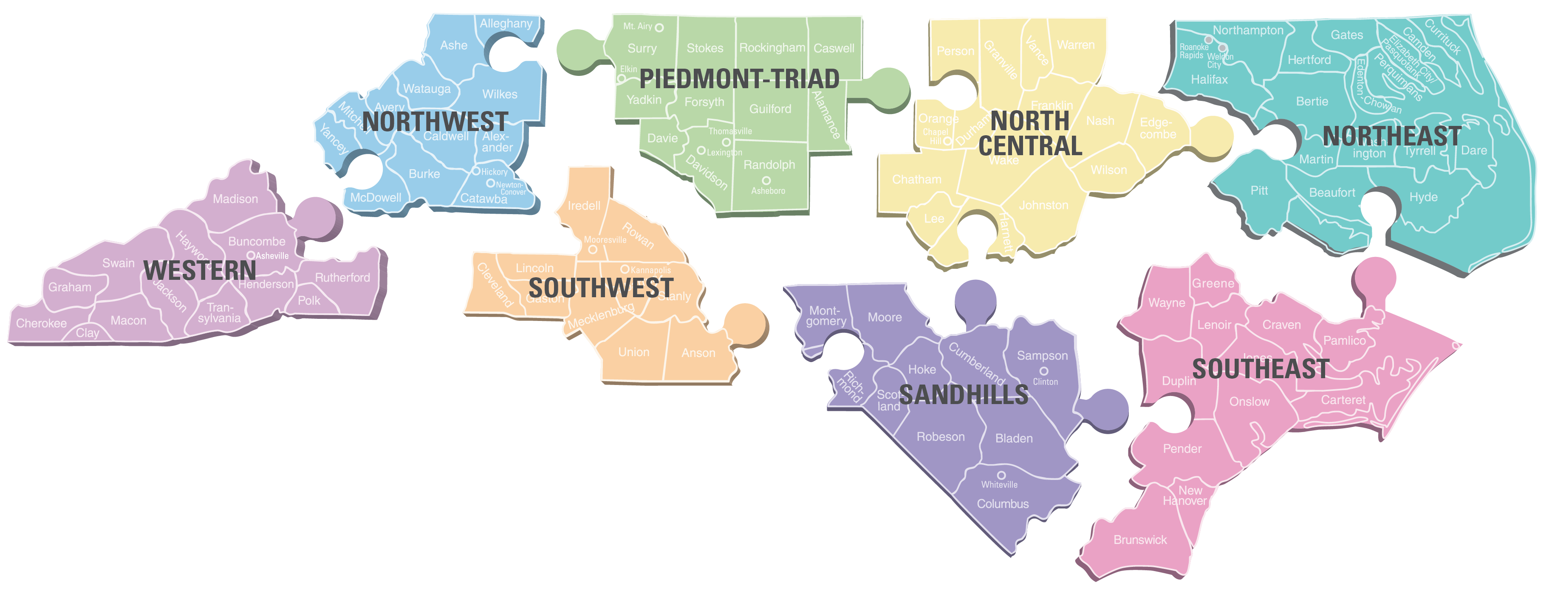
The Regional Support Structure
Regional Case Managers
Career and Technical Education
Digital Teaching and Learning
Exceptional Children
Federal Program Monitoring & Support
Integrated Academic and Behavioral Support Consultant
K-3 Literacy
Office of Early Learning
Regional Accountability Coordinators
Regional Education Facilitators
NCVPS

Slide 3
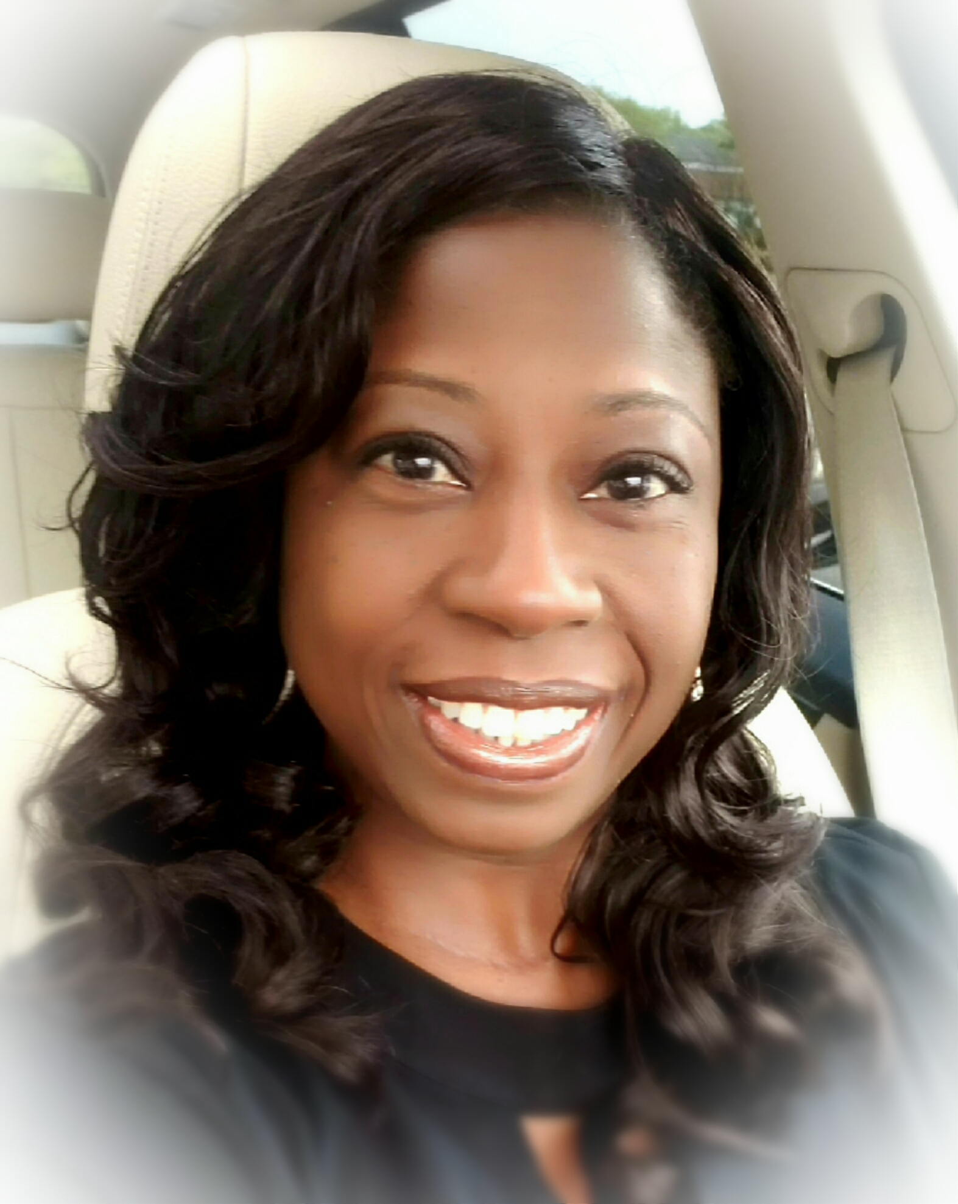
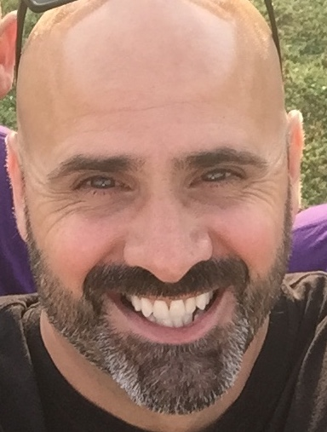
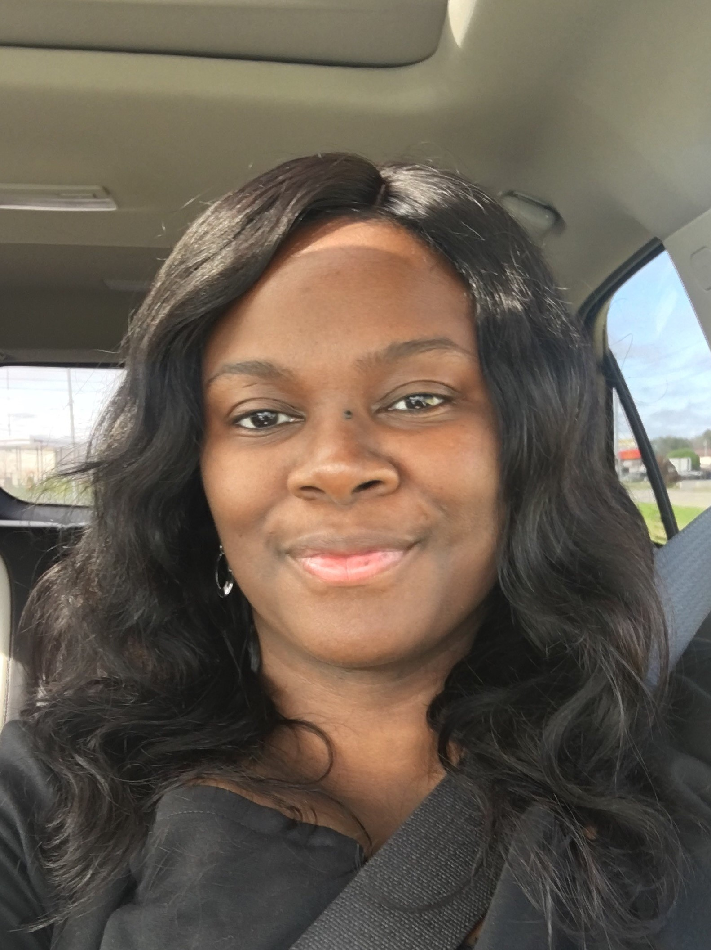
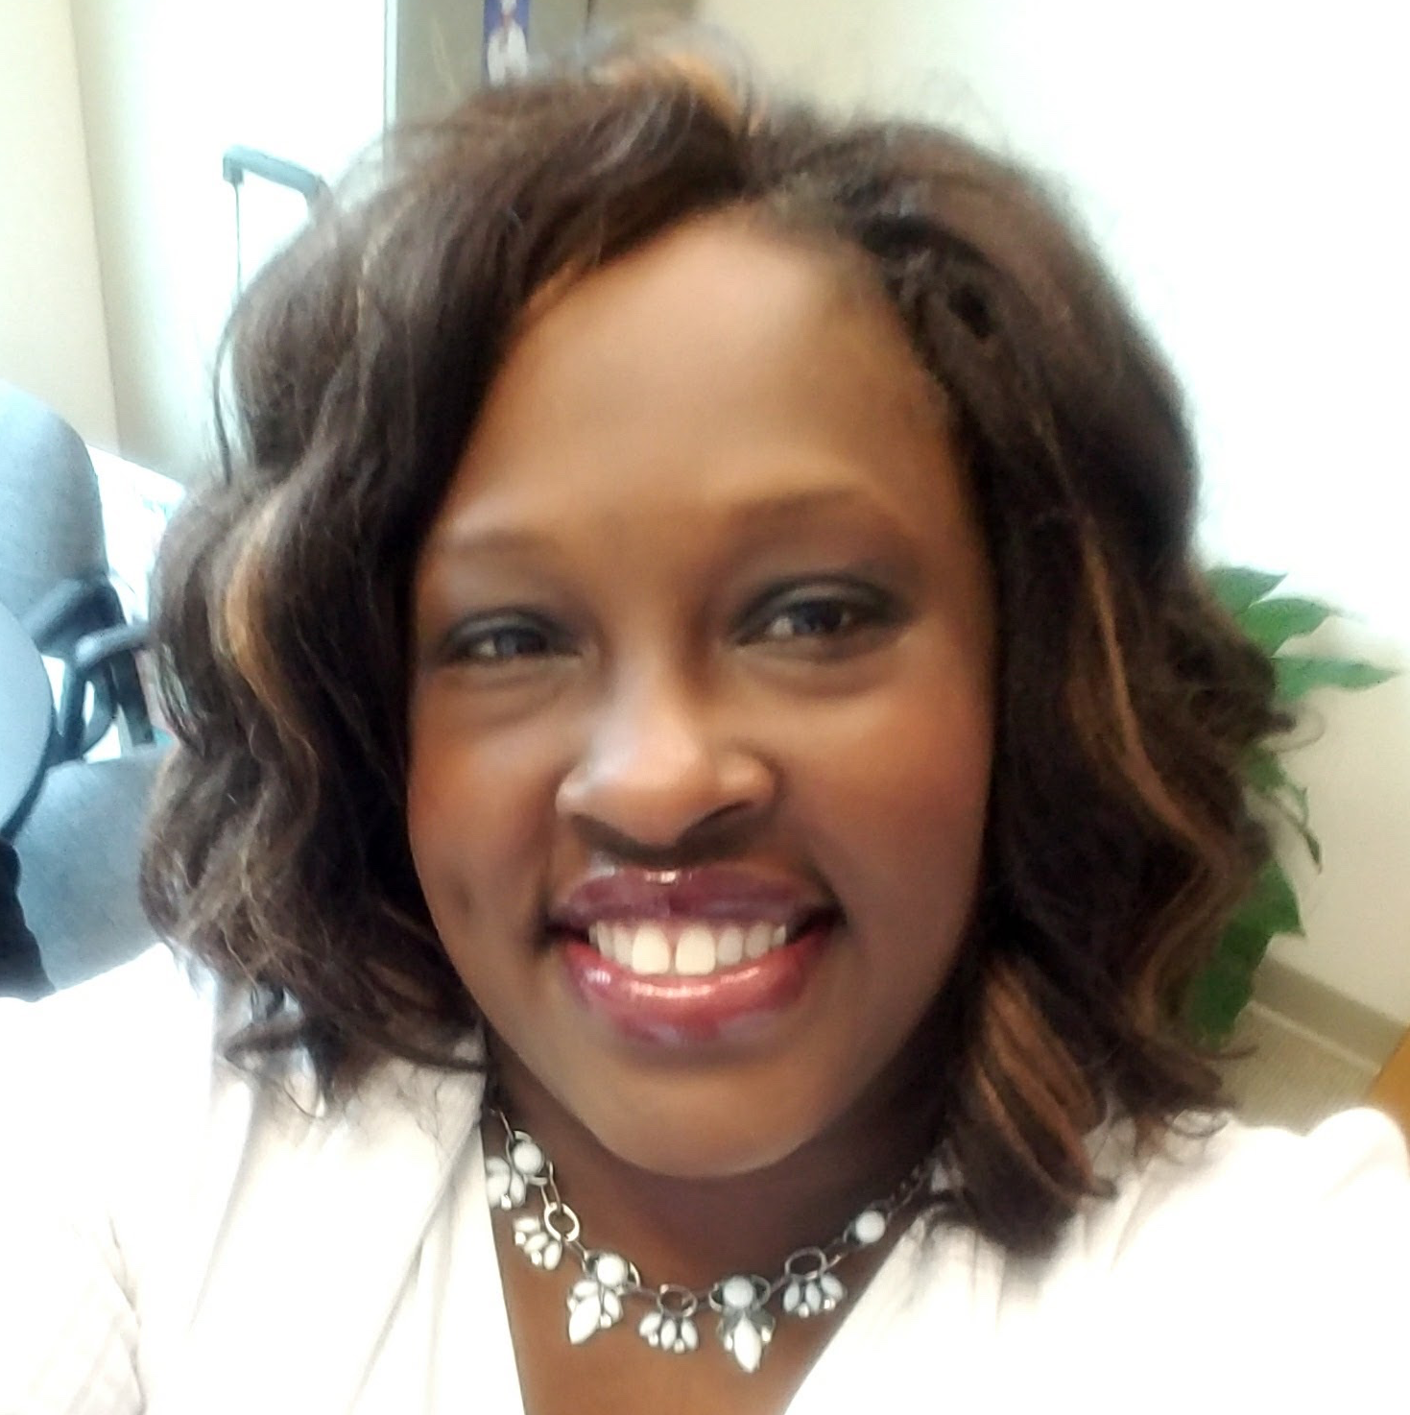
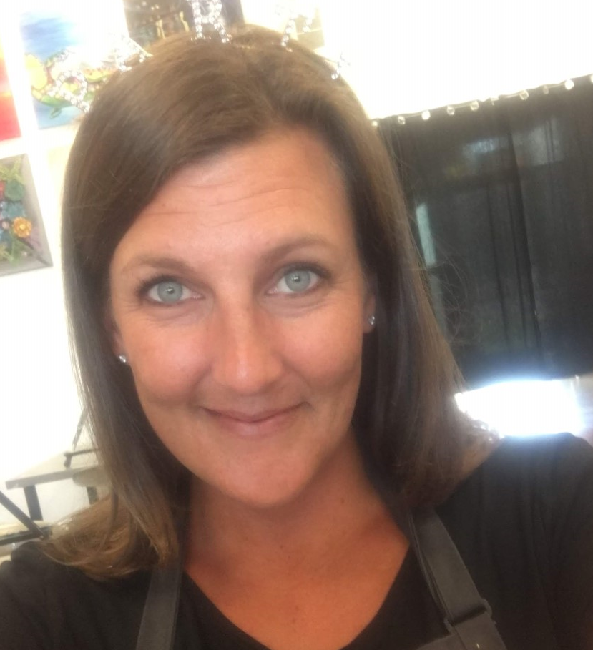
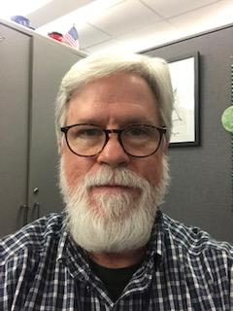
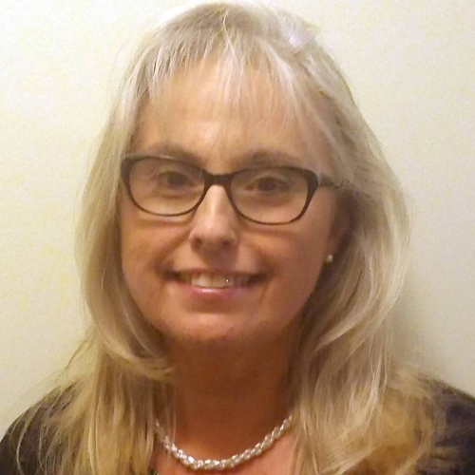
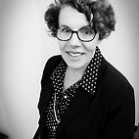
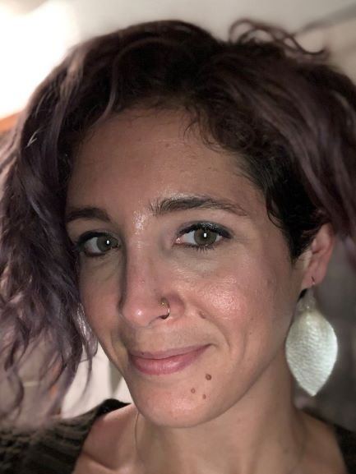
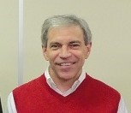
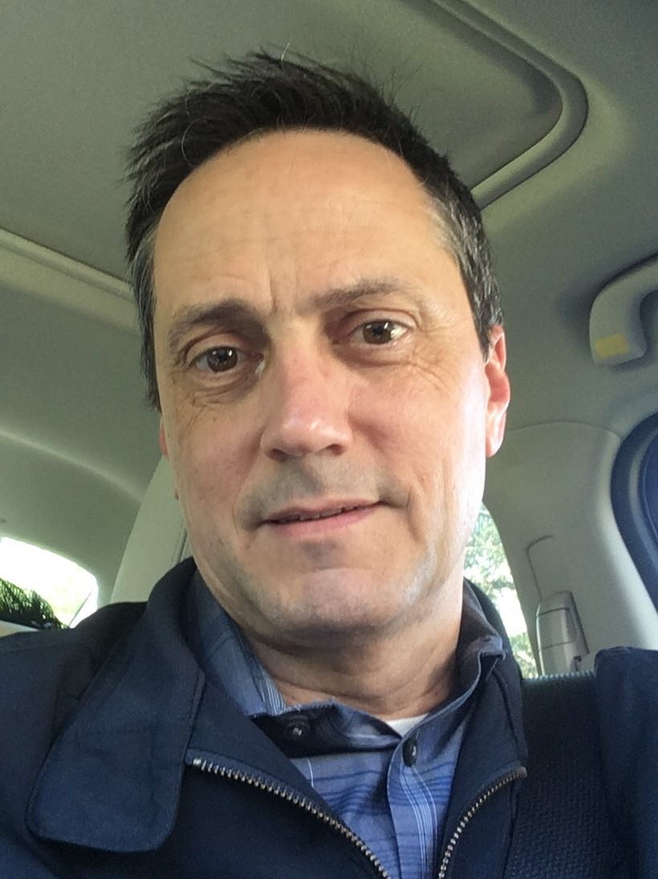
North Central Regional Support Team
Melany Paden, Ed.S.
North Central Regional Case Manger
Melany.paden@dpi.nc.gov
919-637-3783
Rhonda Holmes
Regional Education
Facilitator
Christopher Coby
District & School Liaison,
NCVPS
Mia Murphy
Chief Operations Officers, NCVPS
Amy Betz
EC Regional Coordinator
Paul Davis
Regional Accountability Coordinator
Cynthia Sartain
Digital Teacher & Learning
Laura Dendy
EC Literacy/Math Consultant
Dr. Alisha Schiltz
Integrated Academic Behavior Specialists Consultant
Bob Gant
CTE Regional Coordinator
Talbot Troy
Federal Programs
Administrator

Slide 4
Redesign the regional structure to better coordinate and differentiate identified supports to LEAs
Desired Outcomes:
Increased coordination across the academic areas at NCDPI
More efficient deployment of agency resources as duplication of effort is reduced
Clear articulation of DPI’s priorities as they relate to programs and associated supports (menu of options)
Increased use of data to drive decision-making
Improved field perceptions on the consistency and quality of supports provided by NCDPI

Slide 5
Regional Case Managers:
Carryout the mission of the Regional Support Structure
Serve as a point of contact and liaison to district superintendents and leadership teams
Collaborate every other week with the RST members (face-to-face or virtually)
Meet weekly as an RCM team to discuss progress (face-to-face and/or virtually)
Participate in ongoing professional learning
Meet monthly with the Guiding Coalition
Collaborate with RESA directors/staff

Slide 7
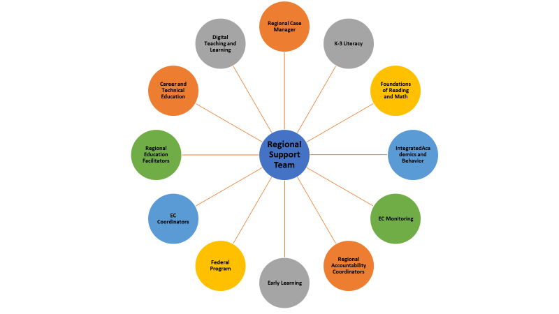
NC DPI Regional Support Structure
Team Member Representation by Division/Unit
* Full job descriptions will by provided via email

Slide 8
NCDPI Regional Support Structure
DPI Has Left The Building!

Slide 9
On the Menu
September 2019
REGISTER NOW!
Registration Information for Low Performing Webinars
NCDPI’s District and Regional Support unit provides a webinar for leaders in these schools and/or districts, whether newly designated or continuing in the designation. Webinars provide information for leaders concerning the policies, expectations, and deadlines for the Comprehensive Plan required for Low Performing Schools and Low Performing Districts, respectively.
PLEASE NOTE: Each webinar, one for Low Performing Schools and one for Low Performing Districts, will be offered twice, and participants need only attend one of the offered webinars. Only leaders in schools and districts who are designated Low Performing need to register.
Please find the registration links below:
Low Performing Districts Webinar Options: (Select one)
Please register for Low Performing Districts Webinar Option 1 on Sep 20, 2019 2:00 PM EDT at:
https://attendee.gotowebinar.com/register/608448145867809292
After registering, you will receive a confirmation email containing information about joining the webinar.
________________________________________________________________
Please register for Low Performing Districts Webinar Option 2 on Sep 23, 2019 2:00 PM EDT at:
https://attendee.gotowebinar.com/register/2610796259001459724
After registering, you will receive a confirmation email containing information about joining the webinar.
___________________________________________________________________________________
Low Performing Schools/Charter Schools Webinar Options: (Select one)
Please register for Low Performing Schools Webinar Option 1 on Sep 20, 2019 3:00 PM EDT at:
https://attendee.gotowebinar.com/register/2988454313886761228
After registering, you will receive a confirmation email containing information about joining the webinar.
________________________________________________________________
Please register for Low Performing Schools Webinar Option 2 on Sep 23, 2019 3:00 PM EDT at:
https://attendee.gotowebinar.com/register/4421001416646399244
After registering, you will receive a confirmation email containing information about joining the webinar.
Professional Learning Opportunities Curriculum and Instruction Leaders Quarterly Webinar Series
This quarterly webinar professional learning series is open to curriculum leaders of all content areas. The Standards, Curriculum, and Instruction Division will provide updates on topics of interest throughout the year. Register once for all four webinars in the series: Tue, Sep 10, 2019 10:00 AM - 11:00 AM EDT Tue, Nov 12, 2019 10:00 AM - 11:00 AM EST Tue, Feb 4, 2020 10:00 AM - 11:00 AM EST Tue, May 5, 2020 10:00 AM - 11:00 AM EDT Registration link - https://register.gotowebinar.com/register/1791917380857089281 Register here

Slide 10
We will provide more details soon about the October 29th sharing session in Charlotte-Mecklenburg
Schools. In the meantime, if you would like to pre-register for the event you can do so here. https://events.r20.constantcontact.com/register/eventReg?oeidk=a07egl58h9yd4da5210&oseq=
https://ncvps.org/nc-virtual-innovators-conference-2019

Slide 11
https://sites.google.com/dpi.nc.gov/ncels/professional-learning

